Slide 1
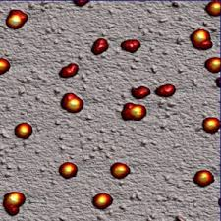
Warm Up 10/4-7
Which organelle is this?
What does it do?
Which level of biological organization is the smallest to be made up of tissues?

Slide 2
ER Questions
What is the ER?
What are the 2 types of ER?
Where do the proteins made on the rough ER end up?
What does the smooth ER do?
How do the lipids and proteins made in the ER move around the cell?

Slide 3
Transfer of Molecules (Osmosis and Diffusion)
Biology 1
Mr. Hedrick

Slide 4
Solution and Solutes
Solution-a homogenous mixture of two or more substances; frequently a liquid solution
Solute-a substance that is dissolved in another substance, thus forming a solution
Solvent-a substance that dissolves other substances, thus forming a solution

Slide 5
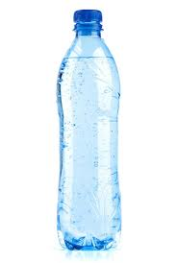
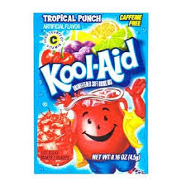
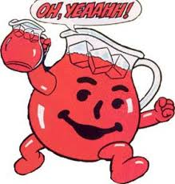
Which is solute, solvent, solution?

Slide 6
Warm Up 10/8-9
Create a Venn diagram comparing and contrasting atoms and cells.
How do the nucleus, ribosomes, and ER all interact with each other?

Slide 7
Golgi Apparatus
How are materials sent to the Golgi apparatus?
Why would proteins and lipids want to “take the bus” to the Golgi apparatus?
What is the Golgi apparatus compared to?
How do vesicles make it out of the cell?
What does the Golgi apparatus actually do?

Slide 8
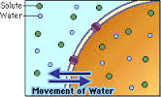
Isotonic
A solution which contains the same concentration of solute as another solution

Slide 9
Hypotonic
A solution which contains a low concentration of solute relative to another solution
The solution on one side of a membrane is less concentrated than on the other side

Slide 10
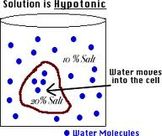
Hypotonic

Slide 11
Hypertonic
A solution which contains a high concentration of solute relative to another solution
The solution on one side of a membrane where the solute concentration is greater than on the other side

Slide 12
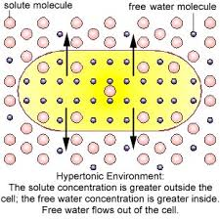
Hypertonic

Slide 13
Diffusion
The movement of molecules from areas of high concentration to areas of low concentration
The process where molecules spread out to form an even concentration

Slide 14
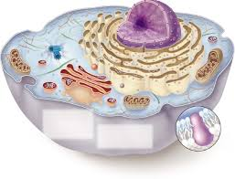
Warm Up 10/10-11
Label the organelles and tell me the functions
1.
2.
4.A Dot in the Cell
3.

Slide 15
Lysosome Questions
What makes lysosomes?
What do they do?
What is inside a lysosome?
How do the lysosomes remove dead organelles?
What are lysosomes compared to?

Slide 16
Osmosis
The diffusion of water across a SELECTIVELY PERMIABLE MEMBRANE.
The movement of a substance dissolved in a solution with lower concentration through a membrane to a solution with a higher concentration

Slide 17
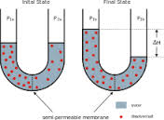
Osmosis

Slide 18
Warm Up 10/14-15
What does selectively permiable mean?
Draw a hypotonic and isotonic solution
REMIND ME TO MAKE PSAT ANNOUNCEMENTS!!!!!

Slide 19
Get to know- Vacuoles
In what type of cells are vacuoles more commonly found?
How much of the cell volume do vacuoles take up?
What is the main function of a vacuole?
How does the vacuole maintain turgor pressure?

Slide 20
Warm Up 10/17-23
Tell me the entire protein story (where the message is stored to how it gets broken down)
What type of cells are most vacuoles in?

Slide 21
Centrioles
What are centrioles made of?
Where does a centriole live and what does it live with?
What are the centrioles needed for?
What do centrioles make?

Slide 22
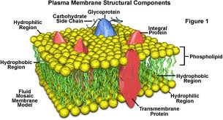
Selectively Permiable
A barrier that allows some chemicals to pass but not others.
The cell membrane is that type of barrier!

Slide 23
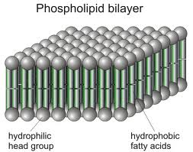
Plasma/Cell Membrane
Plasma Membrane is a phospholipid bilayer with hydrophilic heads and hydrophobic tails
Loves water
Hates water

Slide 24
Passive Transport
Does not require energy to move molecules across a membrane
Ex: diffusion, osmosis, facilitated diffusion, filtration

Slide 25
Warm Up 10/24-25
What makes the plasma membrane? What makes the heads and the tails unique?
What is passive transport? What types of things can the cells obtain through passive transport?

Slide 26
Active Transport
Uses energy to move substances across a membrane
Moves against a concentration gradient
Ex: sodium-potassium pump, exocytosis, endocytosis

Slide 27
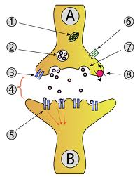
Exocytosis
The process by which cells excrete waste and other large molecules

Slide 28
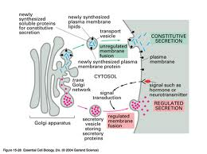
Exocytosis

Slide 29
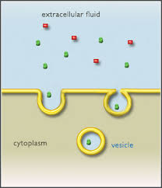
Endocytosis
The process by which cells absorb molecules from outside the cell by engulfing it with its cell membrane

Slide 30
Endocytosis

Slide 31
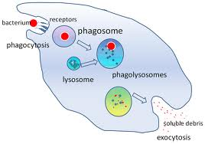
Phagocytosis
“cell-eating”
The process by which cells ingest large particles

Slide 32
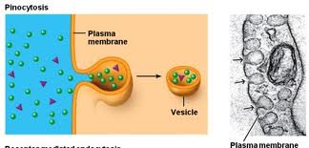
Pinocytosis
“cell drinking”
Liquids and small particles are moved into membrane

Slide 33
Phagocytosis and Pinocytosis
May result in the cell engulfing non-specific or unwanted particles
What happens then?

