Slide 1
Warm Up 4/17
How does available energy change as we move up an ecological pyramid?
How is a food web different from a food chain?
What is composed of similar types of living and nonliving factors across the globe?

Slide 2
Review
Write a brief narrative about what is going on in these pictures.

Slide 3
Succession
Mr. Hedrick

Slide 4
Ecological Succession
Change in the species composition of a community over time
Succession occurs at large scales involving plants and animals from various trophic levels
It may also occur on a smaller scale involving microbial communities.

Slide 5
Two Types
Primary succession
Secondary succession
Using your book, compare and contrast the two forms of succession.

Slide 6
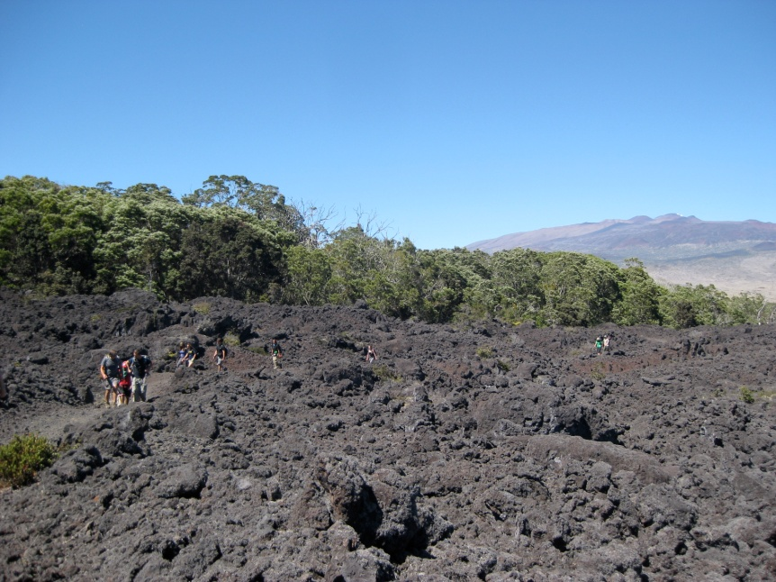
Primary Succession
Rock to forest
Follows the formation of new land surfaces consisting of rock, lava, volcanic ash, clay or some other exclusively mineral substance
No soil and no organic matter

Slide 7
Primary Succession
0 years
500+ years

Slide 8
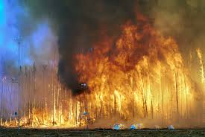
Secondary Succession
Follows the destruction or partial destruction of the vegetation by some sort of disturbance.
Requires soil
Occurs faster than primary succession
Come up with a list of natural destructive forces

Slide 9
Secondary Succession

Slide 10
Secondary Succession

Slide 11
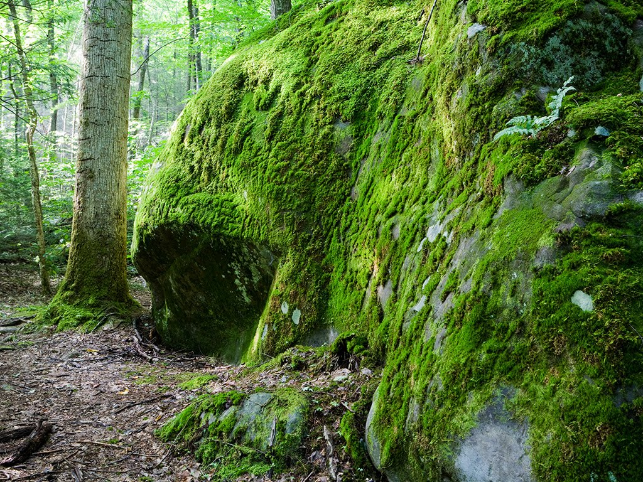
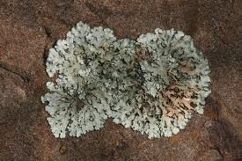
Pioneer Species
Primary pioneers
Moss
Lichen
Plants
Initiate recovery
What are some pioneer species for primary succession?
What are some pioneer species for secondary succession?

Slide 12
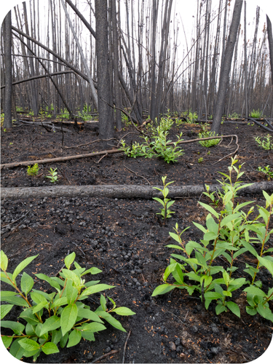
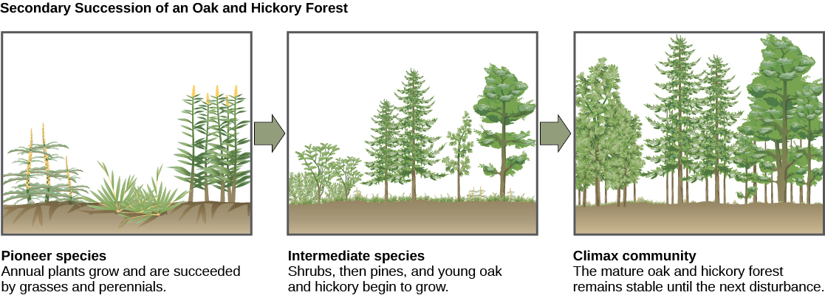
Pioneer Species
Start from roots or seeds remaining in the soil or carried in by other means.
Grass
Small bushes

Slide 13
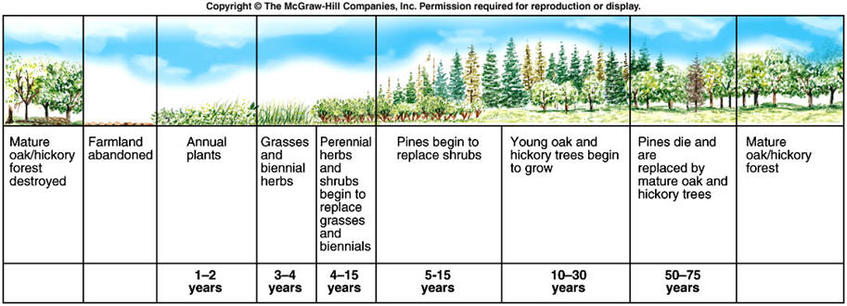
Climax Community
Climax community describes an end product of succession
Will persist until disturbed

Slide 14
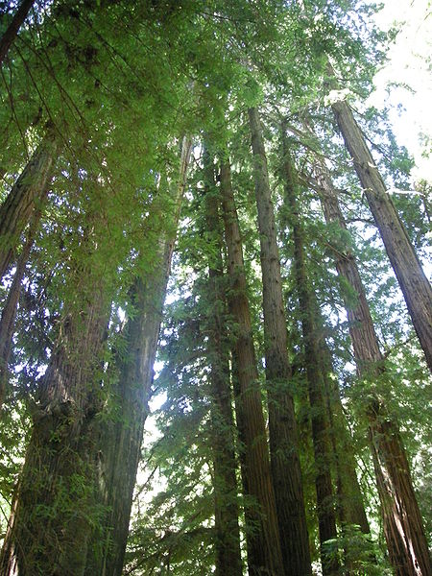
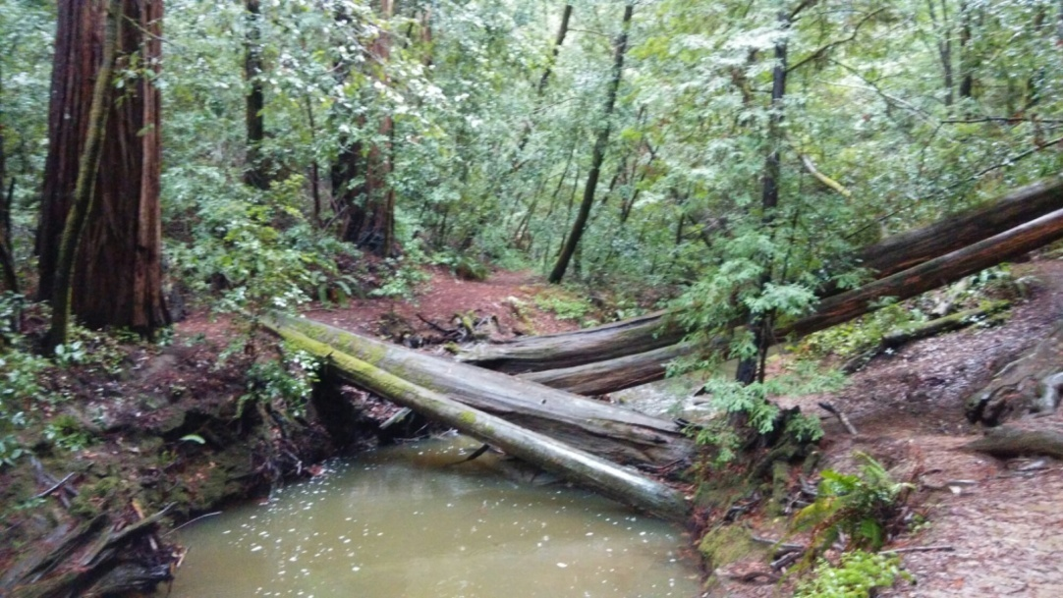
Climax Community

