Slide 1
Warm up
What are the 3 components of a nucleotide? Which component changes based on the nucleotide?
What is a chromosome? Where is it located? What is it constructed of?

Slide 2
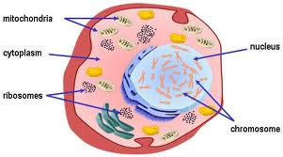
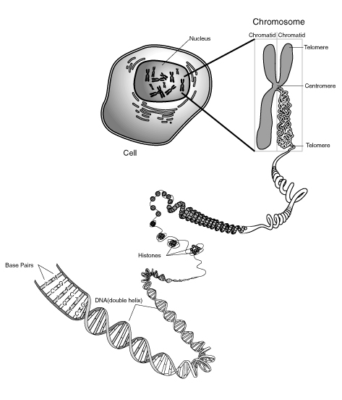
Chromosomes
Tightly coiled bundles of DNA and protein

Slide 3
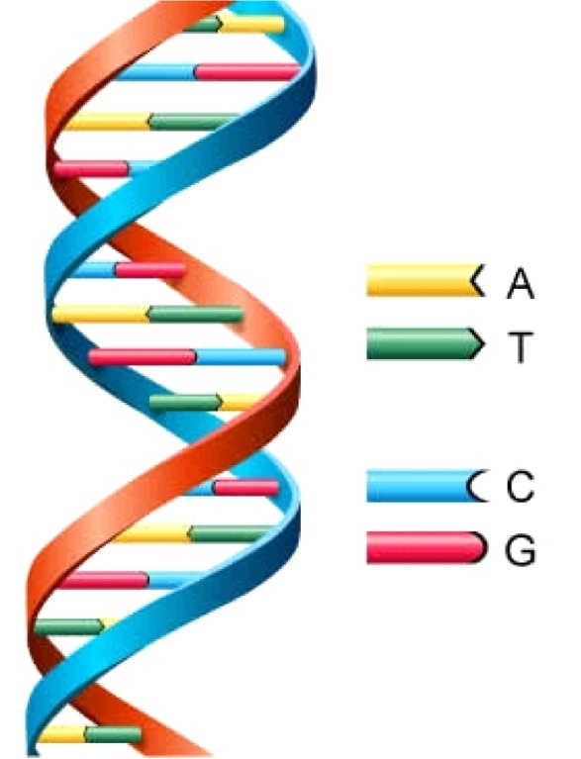
DNA
DOUBLE HELIX
Made of nuleotides

Slide 4
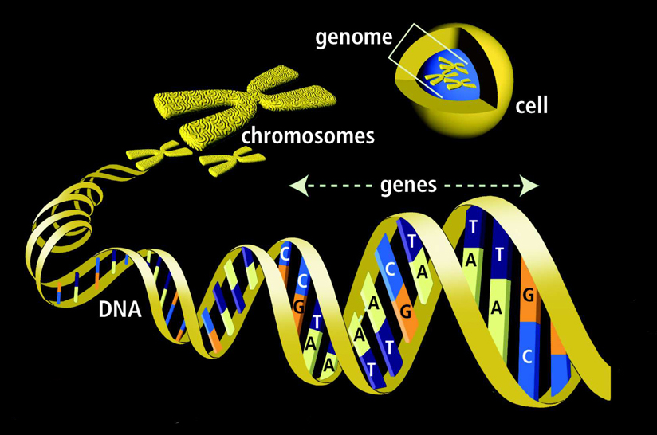
Genes
Sections within the much longer DNA sequence
Give us our traits
The blueprint or plan for a particular protein
DNA is organized into genes

Slide 5
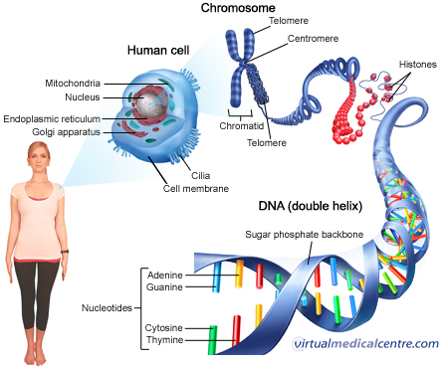
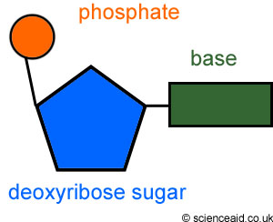
Nucleotide
3 parts
Deoxyribose
Phosphate group
Nitrogenous base
Adenine
Thymine
Guanine
Cytosine
Adenine
Thymine
Guanine
Cytosine

Slide 6
Big Picture

Slide 7
Warm Up 12/6-9
What is DNA replication?
How is RNA the same as DNA? How is it different?

Slide 8
How does DNA replicate and produce RNA?
DNA unzips for 2 reasons:
DNA replication, before the cell can divide
RNA transcription, to send information out of the nucleus
DNA cannot directly produce proteins
http://www.youtube.com/watch?v=teV62zrm2P0

Slide 9
RNA
Ribonucleic Acid
Consists of a long chain nucleotides
Made up of a 5-carbon sugar(ribose), phosphate group and a nitrogenous base

Slide 10
Nitrogenous bases for RNA
Adenine
Guanine
Uracil
Cytosine

Slide 11
3 types of RNA
mRNA (messenger RNA)
rRNA (ribosomal RNA)
tRNA (transfer RNA)

Slide 12
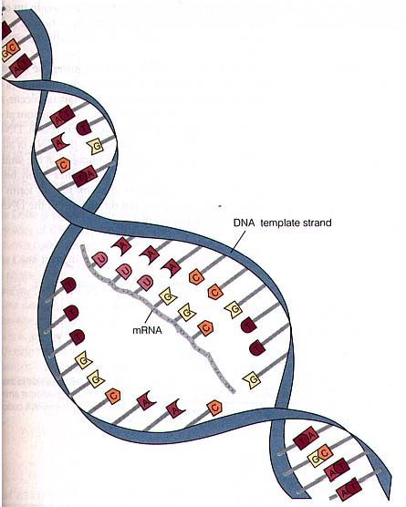
mRNA
The RNA molecule that carries from DNA to the rest of the cell
Transcription: first step in protein synthesis. RNA copies the DNA template

Slide 13
rRNA
The central component of the ribosome
Attaches to the mRNA to hold it together during translation
Translation: second step in protein synthesis. mRNA is decoded into a protein.

Slide 14
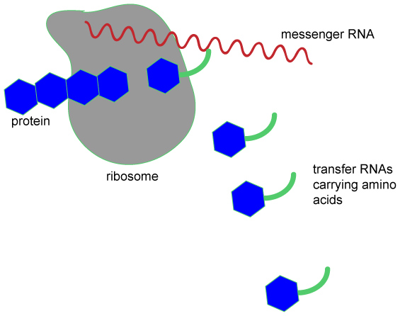
tRNA
Transfers each amino acid to the ribosome to help assemble protein
Each tRNA carries only one kind of amino acid
Each tRNA carries three unpaired bases called an anti-codon

Slide 15
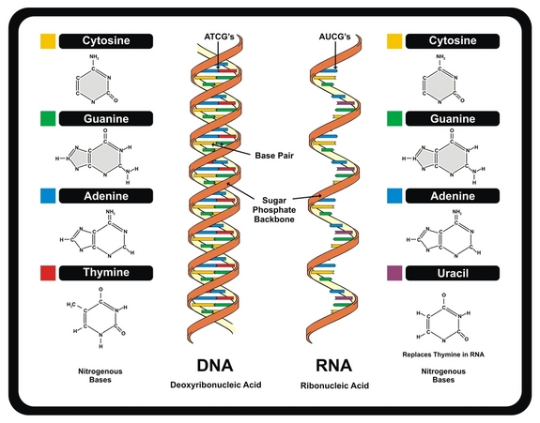
Seeing it

Slide 16
DNA vs. RNA
DNA
RNA
Cookbook
Double strand
Sugar is deoxyribose
Larger molecule
Stores info.
Thymine
More stable
Nucleus
Recipe
Single strand
Sugar is ribose
Smaller molecule
Stores-codes info. and makes protein
Uracil
Less stable
Nucleus, cytoplasm and ribosome

Slide 17
Protein review
Macromolecules
Regulate rate and pattern of growth in an organism
Enzymes (type of protein) catalyze and regulate chemical reactions throughout the body
RNA is the bridge to DNA and the proteins which it codes

Slide 18
Next time
Protein Synthesis
Transcription and Translation

