Slide 1
Warm Up 1/6-7/15
What was the most interesting thing that you did over Winter Break?
Create a double bubble map comparing/contrasting DNA and RNA

Slide 2
Protein Synthesis Transcription and Translation
Mr. Hedrick
Biology 1

Slide 3
Protein Synthesis
The making of proteins. RNA acts as a bridge between DNA and the proteins which it codes
Two processes are involved
Transcription
Translation
http://www.youtube.com/watch?v=5iS4CRPPDus

Slide 4
Transcription
The process when RNA copies part of the DNA nucleotide sequence
Helicase (what does –ase mean?) unzips DNA
RNA polymerase glues together the RNA nucleotides based on the DNA template
Occurs in the nucleus

Slide 5
Transcription

Slide 6
If Helicase
unzips the DNA strand,
THEN
How does RNA polymerase know where to start and stop making an RNA copy of DNA?
RNA polymerase binds to places on the DNA molecule known as…
PROMOTERS

Slide 7
To make 1 protein must the entire DNA chain be copied?
NO
Why?
Because only certain sections of DNA code for a protein and what were those sections called?
GENES

Slide 8
Genes

Slide 9
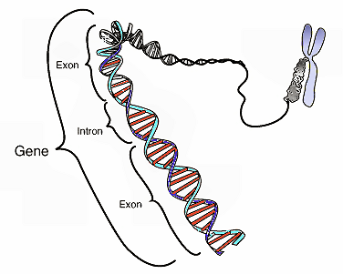
DNA sequences of nucleotides
Introns
Do not code for a protein
Exons
Code for protein

Slide 10
Transcription
The mRNA molecule is formed and both the introns and exons are copied
While mRNA is in the nucleus the introns are cut (spliced) out and the remaining exons are spliced back together
The final mRNA is then formed and leaves the nucleus

Slide 11
Transcription

Slide 12
Translation
Occurs after transcription
Occurs in cytoplasm and at the ribosomes

Slide 13
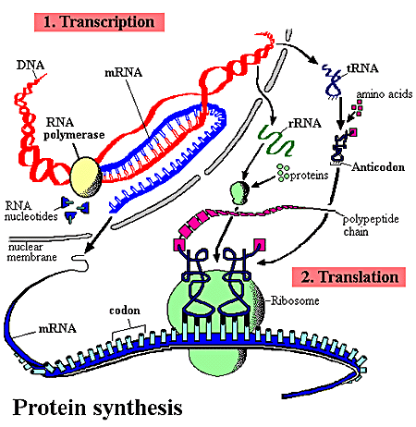
Translation

Slide 14
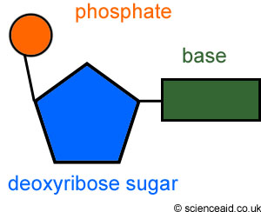
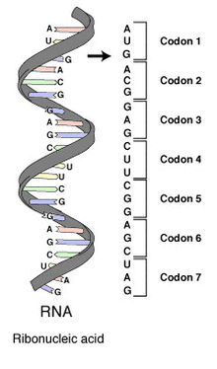
What is a Codon?
A group of three nucleotides
A codon represents an amino acid,
OR
it is a start or stop codon

Slide 15
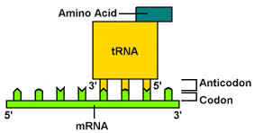
Codons
Start Codons
Stop Codons
AUG for RNA (most typical in eukaryote celled organisms)
ATG for DNA
UAG in RNA
TAG in DNA

Slide 16
Universal Genetic Code

Slide 17
tRNA
Transfers each amino acid to the ribosome to help assemble proteins
Each tRNA carries one specific amino acid
Each tRNA carries three unpaired bases called an anticodon

Slide 18
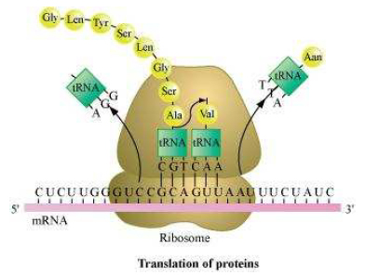
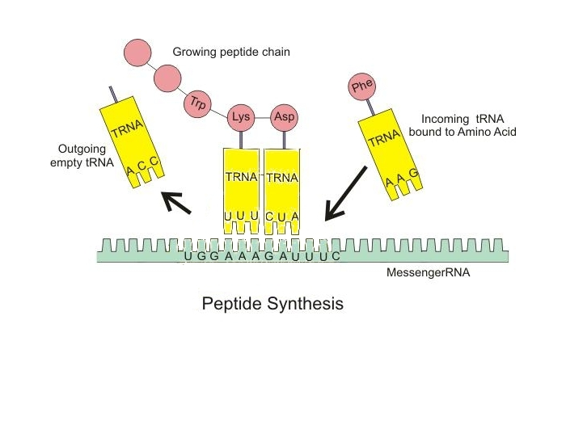
tRNA

Slide 19
Making a Protein
The directions for making a protein are in order of the four nitrogenous bases.
This code is read three letters at a time, known as a codon.
Each codon represents an amino acid.
tRNA moves through the ribosome and its anticodons match up with the mRNA codons.
The amino acids carried by the tRNA are attached until the protein is complete

Slide 20
Central Dogma
DNA
Transcription
RNA
Translation
Protein
Cookbook
Copy specific recipe
Delivers recipe to chef
Chef calls for ingredients
Dinner is served

Slide 21
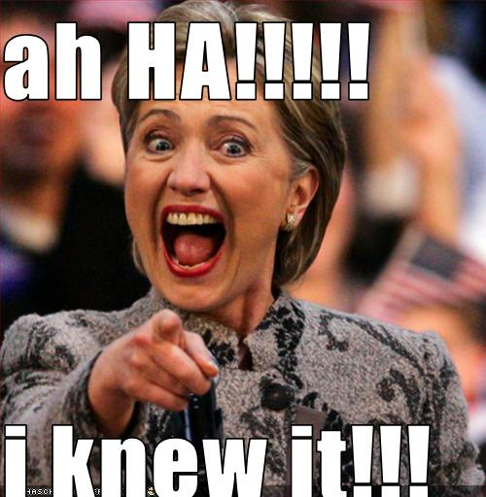
Protein synthesis
Making proteins!
http://www.youtube.com/watch?v=5iS4CRPPDus

Slide 22
Warm Up 12/12-13
What is a codon?
What are the 3 bases on the end of a tRNA called?

