Slide 1
Warm Up 10/28-29/15
Create a double bubble map comparing/contrasting autotrophs/heterotrophs.
Tell me, in your own words, why ATP is so important for organisms.

Slide 2
Warm Up 11/3-4/15
Please write down these questions to be answered with a video:
How are materials sent to the Golgi apparatus?
Why would proteins and lipids want to “take the bus” to the Golgi apparatus?
What is the Golgi apparatus compared to?
How do vesicles make it out of the cell?
What does the Golgi apparatus actually do?

Slide 3
Warm Up 10/30-11/2/15
What are the products of photosynthesis?
Please write down these questions to answer for our video:
What is made in the ER?
What does the ER do?

Slide 4
Warm Up 10/26-27/15 Ribosomes
Please copy down these questions and we will answer them with a video:
Where do the instructions to make proteins come from?
How do the instructions for making a protein make it out of the nucleus?
Where are the proteins made?
What are the ingredients for proteins?

Slide 5
Warm Up 11/6-9/15
Please write down the following questions and we will answer with a video:
What makes lysosomes?
What do they do?
What is inside a lysosome?
How do the lysosomes remove dead organelles?
What are lysosomes compared to?

Slide 6
Warm Up 11/12-13/14
Create a flow map detailing the entire protein story (where the instructions are stored to where the proteins are broken down)
What do plants need from the environment to do photosynthesis?

Slide 7
Vacuole
What do vacuoles do?
What do contractile vacuoles do?
How are food vacuoles made?
What other organelle do food vacuoles sound like?

Slide 8
Warm Up 12/2/14
Look at your protein story flow map. Today we will be writing a paragraph about the protein story to be TURNED IN. Both the flow map and paragraph need to be turned in. I will go over expectations about the paragraph when class starts.

Slide 9
Photosynthesis
Mr. Hedrick, Mrs. Heins
Biology 1

Slide 10
Overview
Most energy on Earth comes from the sun.
What things directly use the sun for energy?
Plants
Algae
Cyanobacteria (photosynthetic bacteria)

Slide 11
Overall Reaction
What is the equation for photosynthesis?
carbon dioxide + water → glucose + oxygen + energy
6CO₂ + 6H₂O → C₆H₁₂O₆ + 6O₂ + energy

Slide 12
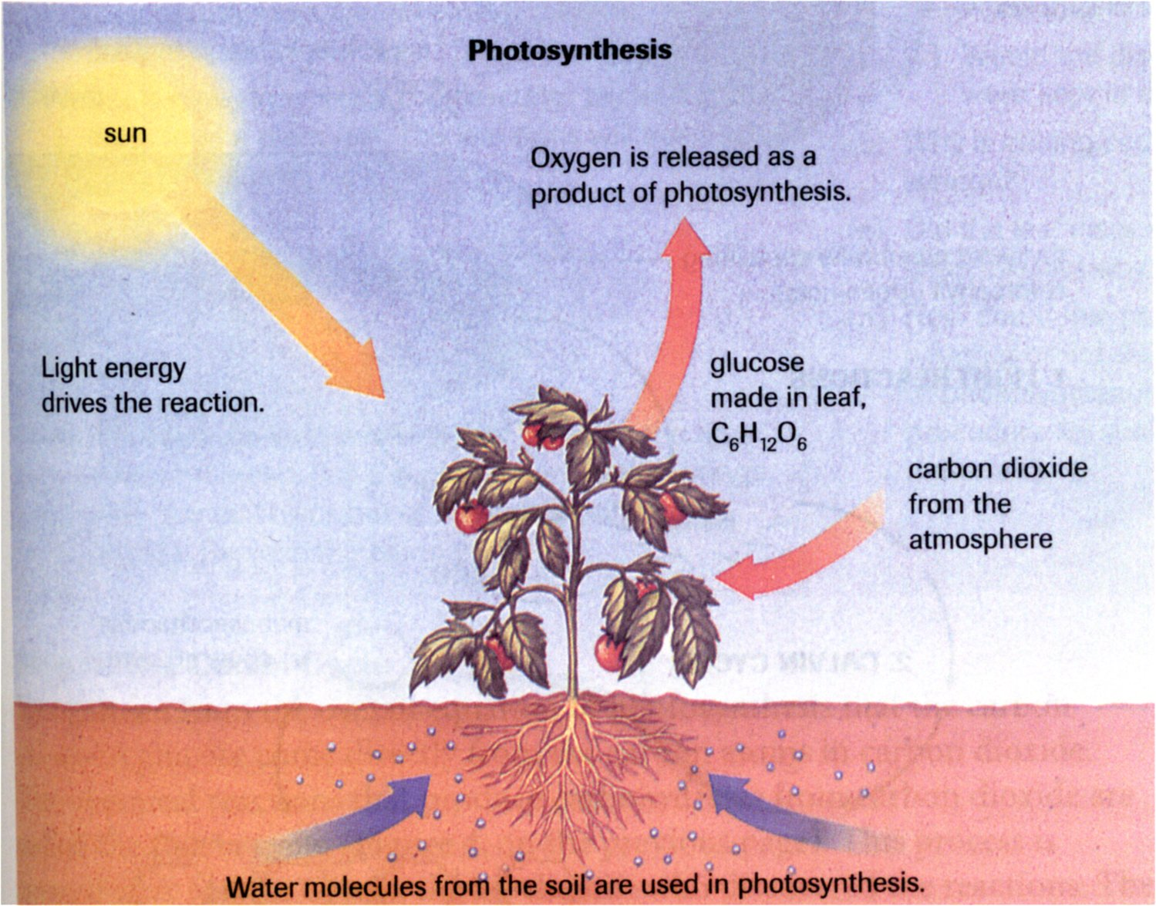
Overview

Slide 13
Overview
1. Carbon dioxide and water are taken in by plants
2. Plants absorb light energy and convert it to a usable form.
ATP
NADPH (Plant ATP)
3. Energy is used to “fix” carbon dioxide into sugar molecules
Chemical energy
4. Sugar is converted to starch and stored for use by the plant, and by animals when they eat plants.

Slide 14
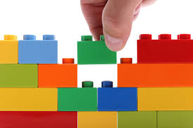
Types of reactions: metabolism
Anabolic:
A chemical reaction that builds molecules
Making proteins from amino acids
Photosynthesis

Slide 15
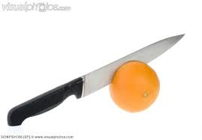
Types of reactions: metabolism
Catabolic:
A chemical reaction that breaks down molecules
Breaking down complex carbohydrates into glucose
Cellular Respiration

Slide 16
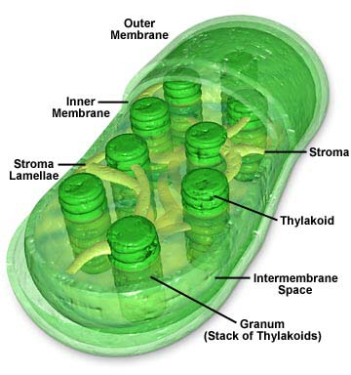
Chloroplasts
Have TWO membranes
A “bi-bilayer!”
The inner membrane is called the thylakoid.
The thylakoid is folded and looks like stacks of coins called grana (granum singular).
The stroma is the space surrounding the granum
Image source: http://www.daviddarling.info/encyclopedia/C/chloroplasts.html

Slide 17
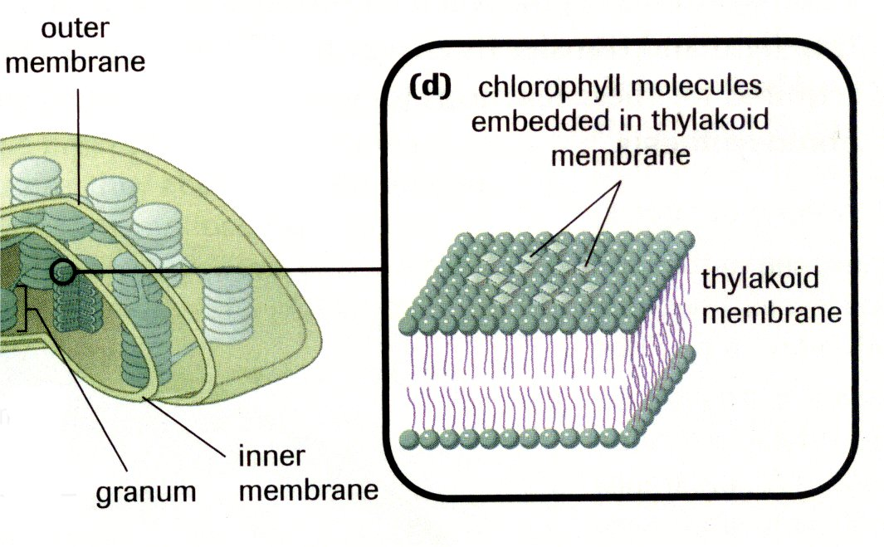
Chloroplasts
Chlorophyll molecules are embedded in the thylakoid membrane
Act like a light “antenna”
These molecules can absorb sunlight energy.
Image from Biology 11: College Preparation. Pg 73. Nelson, Toronto. 2003.

Slide 18
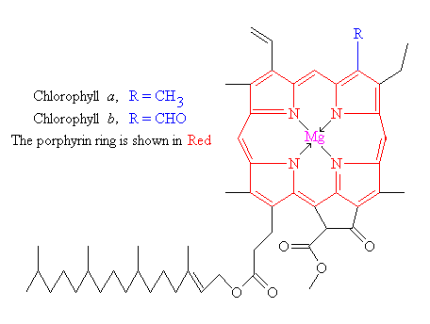
Chlorophyll (more like borophyll)
A molecule that traps light
2 types: chlorophyll a and b
Accessory pigments also help in the process (Beta carotene, etc.)

Slide 19
Warm Up 11/10-11/15
Explain the general process of photosynthesis (what is used, what is made) and write the chemical formula.
What happens in an anabolic reaction? What happens in a catabolic reaction?

Slide 20
Photosynthesis Video
Which organisms can carry out photosynthesis?
What is happening during photosynthesis?
What are the clusters of chlorophyll inside the thylakoids called?
How has the oxygen from the atmosphere been created?
Where does the Calvin cycle take place?

Slide 21
Light Reactions
Happen ONLY in sunlight
Hence they depend on light!
Light is absorbed by chlorophyll molecules in the thylakoid of the chloroplast which excites electrons (e⁻) from water taken in.
This energy then goes down an electron transport chain.
The energy generates 2 ATP and 2 NADPH (what type of macromolecule is this?).

Slide 22
Light Reactions

Slide 23
Calvin Cycle
NADPH and ATP from the light reactions go into the Calvin Cycle.
The cycle repeats 6 times using 6 CO₂.
1 glucose is made.
Can happen in light or dark

Slide 24
Calvin Cycle

Slide 25
Calvin Cycle
The Calvin Cycle sequesters carbon.
Talk to a partner about what you think sequestering carbon means and write your answers in your notes.

Slide 26
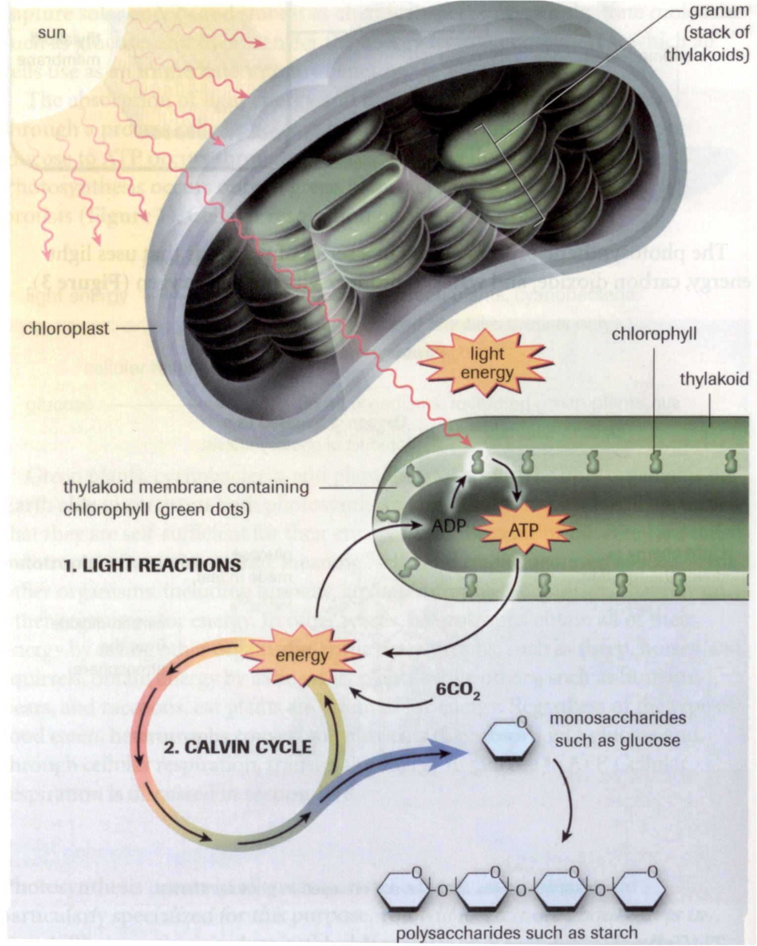
Summary
Image from: Biology 11: College Preparation. Pg 74. Nelson, Toronto. 2003.

Slide 27
Create a Brace Map
Create a brace map (whole and part relationship) detailing photosynthesis.

