Slide 1
Microscopes
Mr. Hedrick, Mrs. Heins, and Mr. Cook

Slide 2
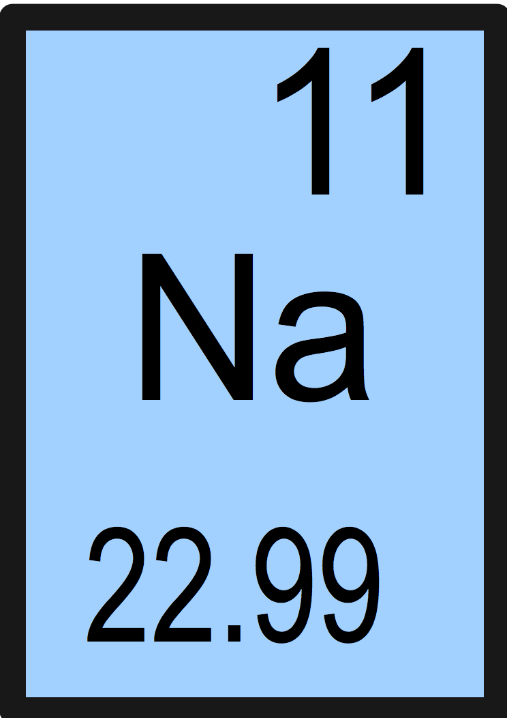
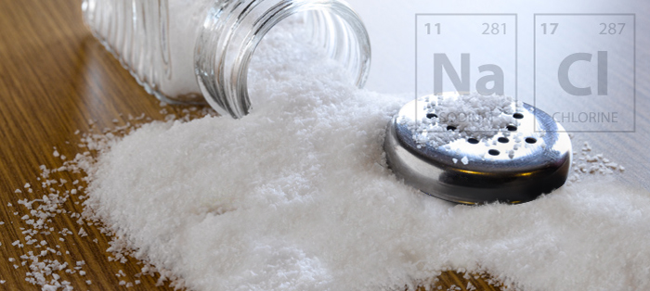
Warm Up
What is this element? What is it’s Atomic Symbol, Atomic Number, and Atomic Mass?
How many Protons does this element have? How does this number related to the number of electrons it has? How is it related to the atomic mass?

Slide 3
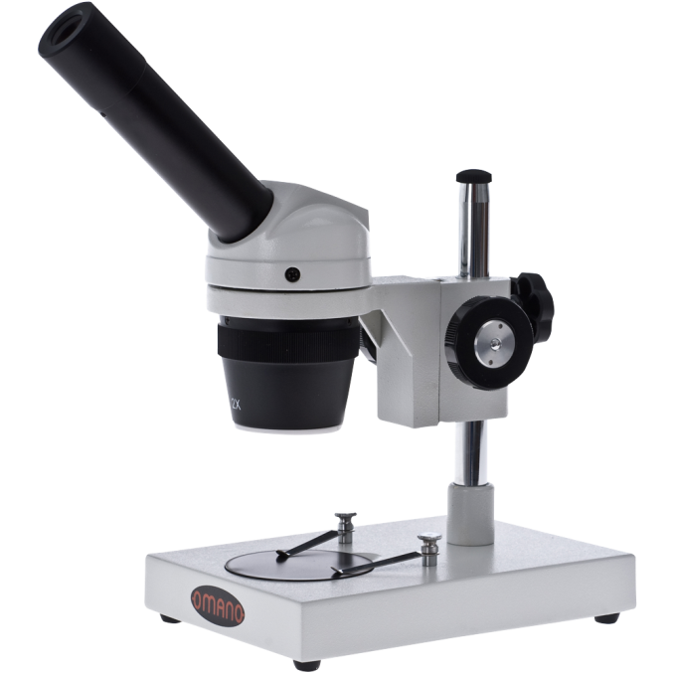
Microscopes
Microscopy: the science of investigating small objects
Electron
Scanning probe
Compound Microscope
Requires prepared lens
Uses?
Dissection Microscope
Sample is placed on the stage
Uses?

Slide 4
Microbiology
The study of microscopic organisms
Virology
Mycology
Parasitology
Bacteriology

Slide 5
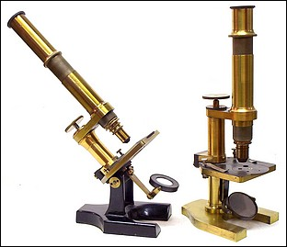
A Brief History
Invented by Zacharias Janssen (contended) around 1590
Not until 1660s and 1670s that microscopes were really used for research
https://www.youtube.com/watch?v=4OpBylwH9DU

Slide 6
Anatomy of a Microscope
We will be using compound microscopes
Function:
Eyepiece
Arm
Objective lenses
Stage/stage clips
Coarse focus
Fine Focus
Iris Diaphragm
Variable intensity control

Slide 7
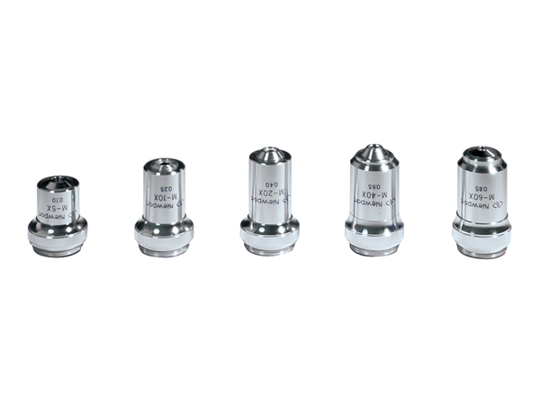
Magnification
Eye piece is w10x
The three objective lenses are:
4x
10x
40x
What is the total magnification for the three objective lenses?
4·10=40x magnification
10·10=100x magnification
10·40=400x magnification

Slide 8
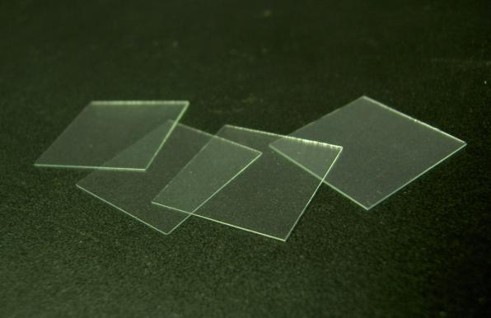
Slide preparation
Take a glass slide
Place subject onto slide
Gently place one drop of water on subject
Gently place a cover slip over subject
Try to avoid air bubbles

Slide 9
Let’s look through the microscope
Please inspect 2 different strands of hair from 2 different people in your group.
Draw a picture of what you see in your notes at 40x, 100x, and 400x.
Label magnification in all pictures!!!!
Please inspect a thin slice of onion.
Take the top layer of onion skin off and inspect that.
Draw a picture of what you see in your notes at 40x, 100x, and 400x.

Slide 10
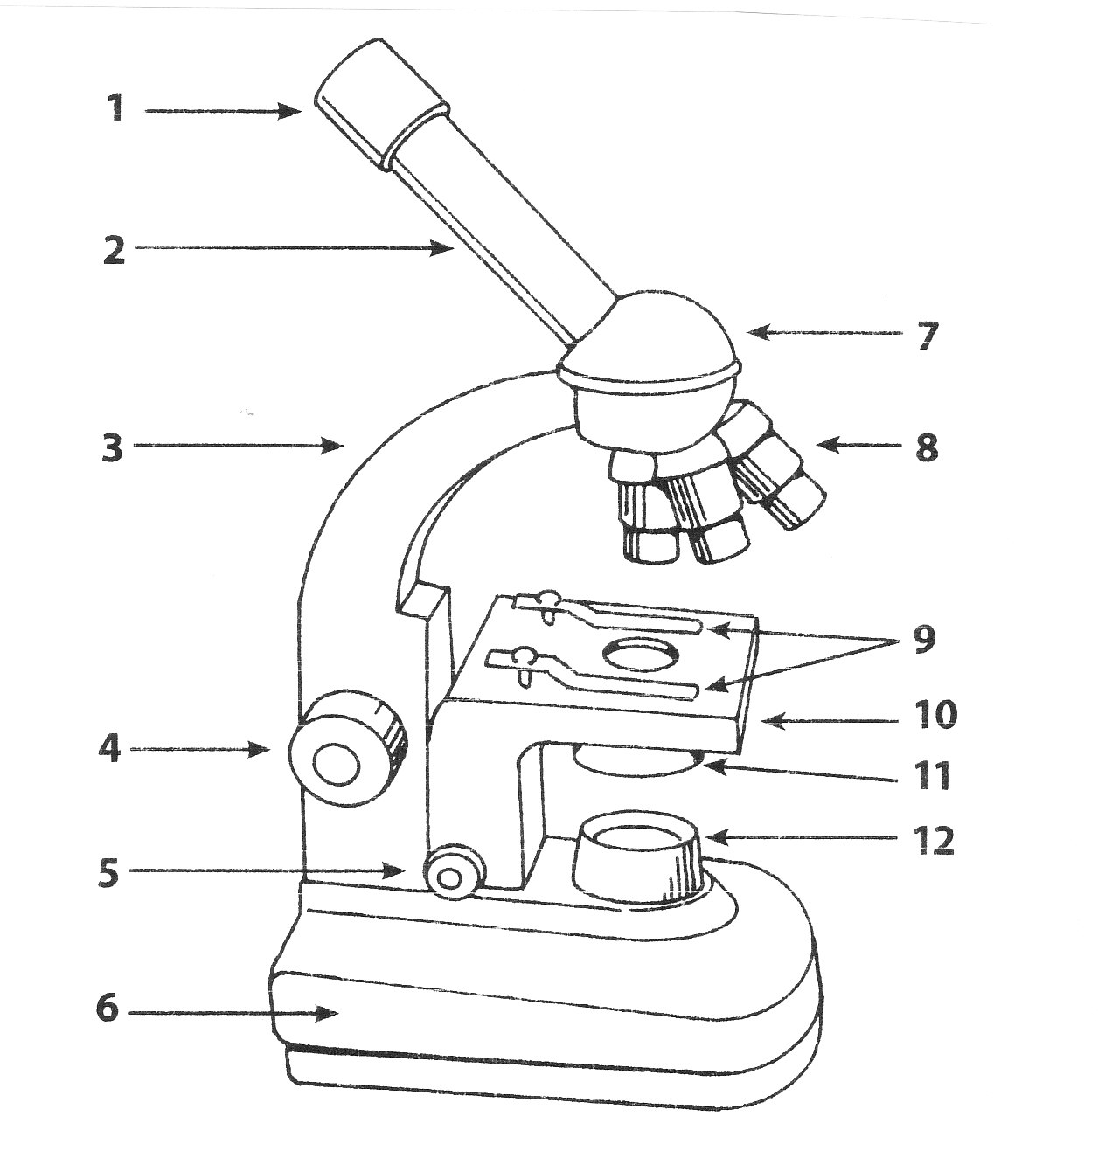
Warm UP
Using the Diagram of the Microscope, label the following:
1.
8.
10.
11.
What type of microscope will be most commonly used in this class? How does it differ from a dissection microscope?
An eyepiece will most commonly have a magnification of what? Using that magnification, how do you figure out the total magnification of the eyepiece and the lens your using?

