Slide 1
Warm Up 1/27-28/15
Draw Anaphase
Which organelle is responsible for producing spindle fibers?

Slide 2
Warm Up 1/29-30/15
Describe what is happening during prophase in mitosis.
How many cells are produced in meiosis? Are they the same or different from the mother cell? Why?

Slide 3
Meiosis
Mr. Hedrick
Biology 1

Slide 4
Review: Cell Cycle

Slide 5
Review: Mitosis

Slide 6
Meiosis

Slide 7
Meiosis
The process in which sex cells (gamete) are reduced to a haploid (½ the chromosomes).
Both egg and sperm cells are haploid cells
Takes place in sex organs
The process of meiosis involves two cell divisions.

Slide 8
Meiosis
Produces daughter cells that are different from the parent cell.
Humans have 46 chromosomes
What would happen if the sperm and the egg each had 46 chromosomes?
If meiosis did not take place the fertilized egg would have double the amount of needed chromosomes

Slide 9
Meiosis
Due to meiosis, offspring receive half of their genetic information from each parent.
The random sorting of chromosomes during meiosis assures that each new sex cell, and therefore each new offspring, has a unique genetic inheritance.

Slide 10
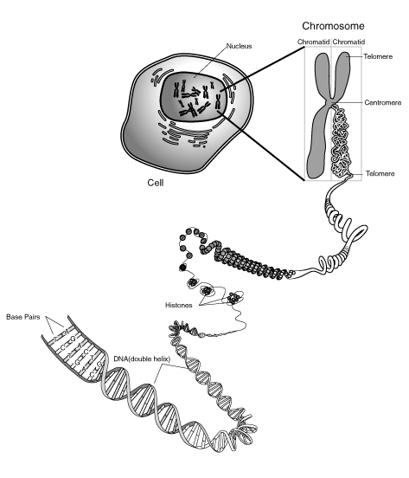
Chromosome Review
What is a chromosome made out of (two things)?
Tightly wound DNA and protein
Two sister chromotids
46 chromosomes, 22 pairs, 2 sex chromosomes
½ from mother, ½ from father.

Slide 11
Human Chromosomes

Slide 12
Terms
In order for us to understand meiosis we must understand the following terms:
Homologous
Crossover
Diploid
Haploid

Slide 13
Homologous
Each chromosome from male parent has a corresponding chromosome from the female parent

Slide 14
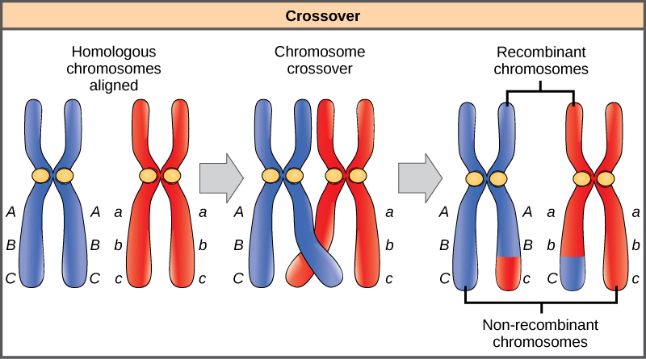
Crossover
The event in meiosis where homologous chromosomes exchange part of their information.

Slide 15
Diploid and Haploid
Diploid
Haploid
Cell containing both sets of chromosomes
Humans 2n=46
Cells containing one set of chromosomes
Humans n=23

Slide 16
Interphase
Cell growth (G₁ , G₂)
DNA replication (S)
We remember this.

Slide 17
Stages of Meiosis
Occurs in two divisions
Meiosis I
Meiosis II
Meiosis I, similar to mitosis

Slide 18
“Gallery Walk”
There are 8 stations around the room (6 lab stations plus 2 additional stations.
You will go to each station to get the information from each.
The picture needs to be drawn along with all the information from slide.
You will also need to find one additional fact, as a group, from the book (p.276)
We will rotate as a class.

Slide 19
Prophase 1
Homologous pairs of chromosomes pair-up and fasten at their centromeres.
Crossover may occur (exchange of genetic information)
Nuclear membrane disappears and spindle fibers form.
Why is crossover important?

Slide 20
Metaphase I
Spindle fibers attach to chromosomes
Chromosome PAIRS (homologs) line up at equator

Slide 21
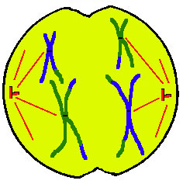
Anaphase I
Homologous chromosomes are pulled apart to their respective poles by spindle fibers.
How many chromatids will each cell have per chromosome?

Slide 22
Telophase I
Marks the end of the first division
Cytoplasm divides forming two new cells
Haploid or Diploid?

Slide 23
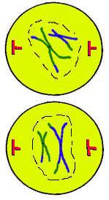
Prophase II
Nuclear membrane breaks down, each daughter cells forms a spindle and chromosomes move to the middle.

Slide 24
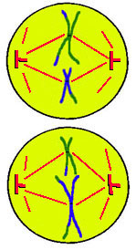
Metaphase II
Chromosomes line up on the equator and attach to spindle.

Slide 25
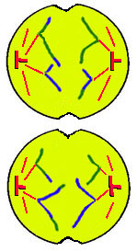
Anaphase II
Spindle fibers pull apart chromosomes.
Are the cells diploid or haploid at this point?

Slide 26
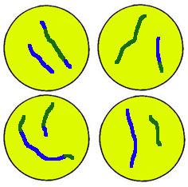
Telophase II
Daughter cells divide
Form four haploid cells with single stranded chromosomes

Slide 27
Meiosis

Slide 28
Why is meiosis important?
Results in daughter cells with half the number of chromosomes needed.
Why is sharing genetic information important for organisms?

Slide 29
Meiosis forms egg and sperm cells.

Slide 30
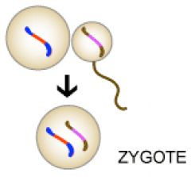
Fertilization
After fertilization the zygote will have half the genetic information of each parent.

Slide 31
Side by Side
Characteristics | Mitosis | Meiosis
Number of daughter cells | 2 | 4
Number of cell divisions | 1 | 2
Daughter cells are haploid or diploid | Diploid | Haploid
Identical or different cells | Identical | Different
Parent cell | Diploid | Diploid

