Slide 1
Introduction to the Biological Sciences
Biology:
Mr. Hedrick and
Mrs. Heins

Slide 2
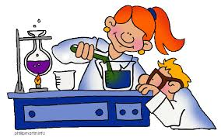
Science
An organized way of gathering and analyzing evidence about the natural world
It is the process by which we ask questions and find answers.

Slide 3
Scientific Method
Also known as scientific problem solving
The process by which we are able to study the world around us.

Slide 4
Scientific Method
State the problem/question (ask a question)
Hypothesis (educated guess in if/then format)
Experiment (procedures and methods)
Analysis of data (results)
Conclusion (accept or reject hypothesis)

Slide 5
Independent Variable
The variable that you control in an experiment
Ex: You are interested in how stress affects heart rate in humans. Your independent variable would be the stress. You can directly manipulate stress levels in your human subjects and measure how those stress levels change heart rate.

Slide 6
Dependent Variable
The observed variable in the experiment
Changes in the dependent variable are determined by the presence or degree of the independent variable(s).

Slide 7
Control Variable
The group where the independent variable is not tested.

Slide 8
Fact
A provable concept
Fact or Fiction
Your body is creating and killing 15 million red blood cells per second.
It takes glass one million years to decompose, which means it never wears out and can be recycled an infinite amount of times!
The two-foot long bird called a Kea that lives in New Zealand likes to eat the strips of rubber around car windows!

Slide 9
Theory
Well-tested explanation of a natural phenominon
A theory will always remain a theory, a law will always remain a law
Ex.
Big Bang Theory
Plate Tectonics
Unified Field Theory
Cell Theory

Slide 10
What is Technology
The tool we use to advance our scientific knowledge and alter the quality of life.
What are tools that have improved your life? Discuss for one minute with someone next to you

