Slide 1
Warm Up 1/28-29
What are 3 names for sex cells?
What is reformed during telophase?

Slide 2
Incomplete dominance, codominance, multiple alleles and polygenic traits
Biology 1
Mr. Hedrick

Slide 3
Law of Independent Assortment
During meiosis, genes for different traits are separated and distributed to gametes independently of one another
If genes are not connected in any way they will follow the Law of Independent Assortment
If genes are on the same chromosome, they will not follow the Law of Independent Assortment

Slide 4
Incomplete Dominance
The heterozygous phenotype is somewhere between the 2 homozygous phenotypes
Neither allele is completely dominant
Traits are blended
http://www2.edc.org/weblabs/incompletedom/incompletedominancemenu.html

Slide 5
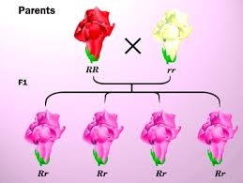

Slide 6
Draw a Punnett Square of incomplete dominance in snap dragons with R=red flowers and W=white flowers
Also complete an F₁ monohybrid cross.

Slide 7
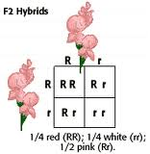

Slide 8
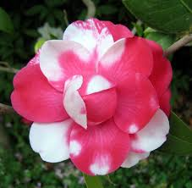
Codominance
Two allele are present at the same time
Traits are not blended

Slide 9
Multiple Alleles
Genes that have 2 or more alleles
Example: Human blood
Alleles are A, B, O
A and B are codominant over O
O is recessive
A and B are codominant

Slide 10
Human Blood Types
The only possible genotype for a type O person is OO
Type A people have either AA or AO genotypes
Type B people have either BB or BO genotypes
Type AB only have the AB (heterozygous) genotype

Slide 11
Video Questions
What is an example of a trait in humans controlled by multiple alleles?
What can cause a baby to have type O blood if his parents are type A and type B?
Which blood type is dominant? Recessive?
Why can’t someone with type A blood be given type B blood for a transfusion?
Why is type O blood called the universal donor?

Slide 12
Polygenic Traits
Traits controlled by many genes
Often have a variety of phenotypes
Ex: hair color, intelligence, height in humans, eye color

