Slide 1
Warm Up 2/18-19/15
Snap Dragons show incomplete dominance. The allele for red is R and the allele for white is r. Cross a purebred white snap dragon with a heterozygous pink snap dragon.
Some cattle show codominance. The allele for white hair is W and the allele for brown hair is B. Cross a brown bull with a white and brown cow.

Slide 2
Human Heredity
Biology 1
Mr. Hedrick

Slide 3
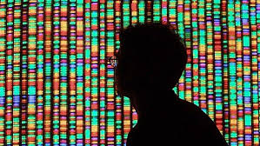
What is a genome?
A full set of genetic information

Slide 4
Human Genome
The Human Genome Project was a 13-year project completed in 2003
Coordinated by the U.S. Department of Energy and the National Institutes of Health.

Slide 5
Human Genome Facts
Genes comprise only about 2% of the human genome.
What is the rest then?
The human genome is estimated to contain 20,000-30,000 genes and 3 BILLION base pairs.

Slide 6
Karyotype
A complete (diploid) set of chromosomes grouped together in pairs, arranged in order of decreasing size.
Human cells have 23 pairs of chromosomes= 46 chromosomes.

Slide 7
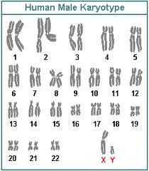
Karyotype

Slide 8
Two types of chromosomes
Sex Chromosomes: 2 of the 46 chromosomes on the human determine an individual’s sex. Females are XX and males are XY.
Autosomes: the rest of the chromosomes

Slide 9
Sex linked genes:
Genes located on the X or Y chromosome
In males, often many of the alleles on the X chromosome are expressed since they are missing on the Y.
http://www.dnaftb.org/13/animation.html

Slide 10
Sex Linked Practice Problem
Colorblindness is a sex linked trait. A mother is heterozygous (a carrier) for the trait of colorblindness and a father is not colorblind. Find the genotype and phenotype of the possible children.

Slide 11
Human Genetics Reading
Please chunk into 4 sections with section 1 ending at “The Daily Mail Reports”, section 2 ending at “…a single coffee-colored skin tone”, section 3 ending at the end of page one and section 4 ending at the end of the reading.
Come up with at least one question for each section and write down any unfamiliar words.

Slide 12
Warm Up 2/20-23/15
A mother has type O blood. Her newborn baby has type B blood. There are 4 potential fathers. One has type O blood, one has type A blood, one has type B blood and one has type AB blood. Which of the potential suitors could not be the baby’s father? Do a Punnett square for each person that COULD NOT be the baby’s father to support your findings.
What is the Law of Independent Assortment?

Slide 13
Warm Up 2/24-25/15
In humans, colorblindness is a sex-linked recessive disease. A woman who is a carrier for colorblindness mates with man who does not have colorblindness. What are the genotypes and phenotypes of the offspring?
In your own words, what is a karyotype?

Slide 14
Pedigree Charts
A chart that analyzes the pattern of inheritance for a particular trait within a family

Slide 15
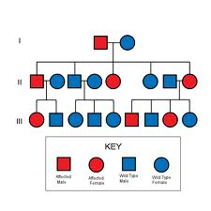
Example:

Slide 16
Pedigree Key
Female Has Trait
Male No Trait
Union
Parental Connection

Slide 17
“Cracking the Code of Life” Questions: Part 1
How are our genes 50% the same as a banana?
What is the human genome compared to?
Why are genes so difficult to map?
How do people get Tay-Sachs?
If you had a 50% chance of passing Tay-Sachs on to your child, would you still have children? Why or why not?

Slide 18
“Cracking the Code of Life” Questions: Part 2
What did Celera push the Human Genome Project to do?
Do you think that Celera is an ethical company?
Should the government even been a part of mapping the human genome once Celera got involved?
Should Celera charge for people to see any genetic code?

Slide 19
“Cracking the Code of Life” Questions: Part 3
How do humans make so many proteins with so few genes?
How does sequencing genes help with disease research?
How many genes did most scientists think we had before the genome was sequenced?

Slide 20
“Cracking the Code of Life” Questions: Part 4
Would you want to be tested for genetic diseases that have no cure? Why or why not?
What would you do if you knew you had the BRCA gene?

Slide 21
Warm up 2/26-27/15
Myopia (extreme near sightedness) is a sex-linked recessive trait. Jim’s father has myopia and Jim’s mother is a carrier for myopia. What is the probability that Jim has myopia?
What is the difference between a karyotype and a pedigree?

