Slide 1
Warm Up 3/30-31/15
Which taxonomic category is going to have more organisms, family or order?
How do we know how old the Earth is?

Slide 2
Warm Up 5/6-7
What was the first life like on Earth? Did it use oxygen? What challenges did it have to overcome?
How many years are there in an Eon?

Slide 3
Geologic Time
Mr. Hedrick, Mrs. Heins
Biology 1

Slide 4
How do scientists date things?
Radioactive dating
Using half-lives, scientists are able to date rocks with a high level of accuracy (usually around 5000 years).
Is that very accurate? Why?

Slide 5
Video Questions
How old is the Earth?
How long ago did life on Earth begin?
What is radioactive dating?
Why is radioactive decay an effective way to date things?
What is a half-life?

Slide 6
Million and Billion
Million = 1,000,000
Billion = 1,000,000,000
There are 1,000 millions in a billion.

Slide 7
Eon, Era, Period
Eons are the largest intervals of geological time
100s of millions of years in duration
Eon, Eras, and Periods do not have equal length
Eons are the largest, followed by Eras, followed by Periods

Slide 8
Eon
Era
Period

Slide 9
Precambrian
Covers the bulk of Earth’s history
Begins with the Earth’s formation (~4.5 bya) and lasts until ~543 mya
Has 3 Eons in it
Hadean Eon
Archean Eon
Proterozoic Eon

Slide 10
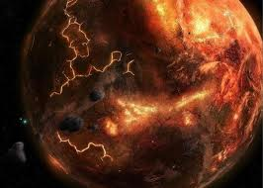
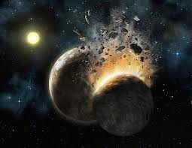
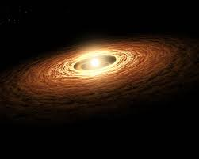
Hadean Eon
4.5 to 3.8 bya
Formation of the Earth from a large cloud of gas and dust from the sun
Earth’s crust cools and solidifies
Moon forms
No known life

Slide 11
Archean Eon
3.8 to 2.5 bya
Atmosphere was mostly composed of methane and ammonia which is toxic to most life
Bacteria first appeared (which type?)
Rocks and continental plates began to form

Slide 12
Proterozoic Eon
2.5 bya to 543 mya
Periods of glaciation, “Snowball Earth”
Oxygen begins to accumulate (how)
Eukaryotes are present
Plate tectonics forming Earth’s crust
Ex. Ozark Mountains, Missouri

Slide 13
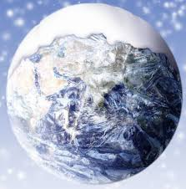
Snowball Earth Hypothesis

Slide 14
Phanerozoic Eon
Began 543 mya to the present
Means “visible life”
3 Eras
Paleozoic Era
Mesozoic Era
Cenozoic Era

Slide 15
Paleozoic Era
6 Periods
Cambrian (543 to 488 mya) fish appear
Ordovician (488 to 443 mya) land plants, primitive fish, seaweeds, worms
Silurian (443-417 mya) spiders, insects, complex plants, fish with bony jaws, fish living in fresh water

Slide 16
Paleozoic Era (continued)
Devonian (417 to 359 mya) amphibians appear, first trees and other plants
Carboniferous (359 to 299 mya) swamps, reptiles, winged insects, cockroaches
Permian (299 to 251 mya) amphibians dominate, cone-bearing plants, largest mass extinction (95% of marine species and 50% of all animals)

Slide 17
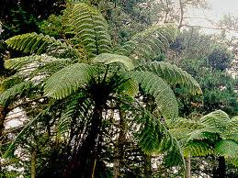
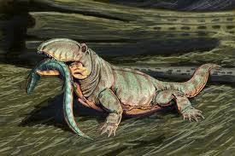
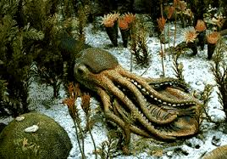
Paleozoic Era

Slide 18
Mesozoic Era
3 Periods
Triassic (251-200mya) mammals, dinosaurs, and crocodiles
Jurassic (200-145mya) dinosaurs dominate, small mammals, birds, palm-like trees, grasses
Cretaceous (145-65mya) flowering plants, bees, butterflies, mass dinosaur extinction

Slide 19
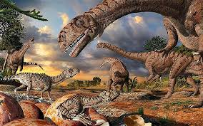
Mesozoic Era

Slide 20
Cenozoic Era
2 Periods
Paleogene (65-23mya) rise of mammals and birds, flowering plants
Neogene (23mya to present) modern humans, 10,000 years ago large mammals went extinct

Slide 21
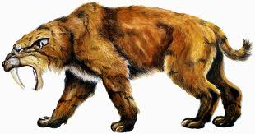
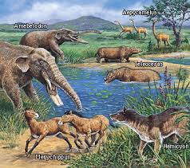
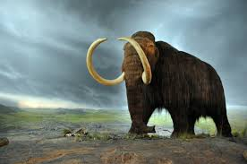
Cenozoic Era

