Slide 1
Warm Up 2/2-3/15
Create a double bubble map comparing/contrasting mitosis and meiosis.
What is happening during interphase of mitosis? Of meiosis?

Slide 2
Genetic Inheritance
Mr. Hedrick and Mrs. Heins
Biology 1

Slide 3
Genetics
The branch of biology that studies hereditary information and how it is passed from parents to offspring.

Slide 4
Heredity
Passing on traits from one generation to the next.
It is why offspring can look like their parents.

Slide 5
Trait
A specific characteristic that varies from one organism to another

Slide 6
Terms to Know
Gene: A specific sequence of DNA that determines a specific trait
Alleles: different forms of a gene
T= tall t=short
G=green g=yellow

Slide 7
Terms Continued
P (parental) generation: parents
F₁ (first filial) generation: first generation from the parents (kids).
What would the F₂ generation be?
Hybrid: organisms produced by crossing purebred parents with differing characteristics

Slide 8
Today we are going to talk about the work of Gregor Mendel!

Slide 9
Gregor Mendel: Father of Genetics
The first to do experiments on traits that are inherited.
Carried out his work on pea plants.

Slide 10
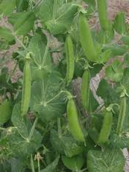
Mendel realized that the pea plant...

Slide 11
Self pollinates
Has male and female parts
And therefore…
It creates identical offspring
Process is called true-breeding

Slide 12
Mendel asked himself…
What if I didn’t allow self-pollination and I cross-pollinated the pea plants?
Cross Pollination-when pollen from one plant fertilizes another
Result-offspring end up being a combination of both parents

Slide 13
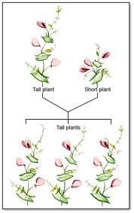

Slide 14
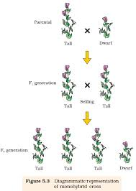

Slide 15
Mendel Concluded:
Through biological inheritance certain factors (genes) are passed from one generation to the next
Some alleles are dominant and others are recessive (remember different form of the gene are called alleles)

Slide 16
Alleles
Dominant: trait shows up if the dominant allele is present, it is represented by a capital letter.
Recessive: trait shows up if a dominant allele is not present, it is represented by a lower case letter.
Can you think of any dominant/recessive alleles? Discuss with your partner and come up with at least 2 traits you think are dominant/recessive.

Slide 17
Warm Up 2/4-5/15
What is the branch of biology that deals with heredity?
Draw Telophase

Slide 18
Law of Dominance
When organisms pure for a trait are crossed, all offspring will show the dominant trait.
Why?

Slide 19
Law of Segregation
Alleles separate so that an offspring gets a trait from each parent.

Slide 20
Video Questions
Which type of plant did Mendel do his research on?
What is an allele?
When Mendel bred one white flower and one purple flower, what were the results?
When he bred those flowers, what were the results?
What is the Law of Dominance?
What is the Law of Independent Assortment?

Slide 21
Genotype and Phenotype
Genotype- which alleles a specific organism possesses (BB, Bb, bb). Having the same alleles is homozygous and having different alleles is heterozygous.
Phenotype- The physical expression of that trait (BB-brown eyes, Bb-brown eyes, bb-blue eyes

Slide 22
Warm Up 2/6-9/15
Today we will be taking a quiz over mitosis and meiosis. We will also be doing binder checks. In your binder you need: mitosis jigsaw/notes, completed mitosis flipbook, meiosis “gallery walk” notes, meiosis worksheet.

Slide 23
Probability and Punnet Square
Probability: the likelihood that something will happen
Punnet square: a diagram that of the possible allele combinations

Slide 24
Punnett Squares 101
Determine which parents are being used (homozygous dominant, heterozygous, recessive)
Determine how many traits are being discussed (always one in this class).
Separate father’s alleles on top and mother’s alleles on the side (do meiosis).
Place combinations in the result boxes.
Determine genotypic and phenotypic ratios.

