Slide 1
Warm Up 3/9/15
In your own words, what is the Law of Dominance?
If a mother who is heterozygous for blood Type A and a father who is heterozygous for blood Type B decided to have children, what could the possible blood types of these children be?

Slide 2
Warm up 3/11-12/15
Draw a picture of nondisjunction and label its parts.
Are genetic mutations good or bad? Why?

Slide 3
Genetic Engineering
Biology 1
Mr. Hedrick and Mrs. Heins

Slide 4
Genetic engineering
Making a change in the DNA code of an organism
Not a natural process
Ex: Genetically Modified Food

Slide 5
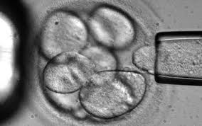
Stem cells
Undifferentiated cell

Slide 6
Presenting Guidelines:
After reading, the following questions must be answered and presented to classmates.
Define any unknown terms.
What subject is your article about?
What does that subject have to do with genetic engineering?
2 interesting facts
How is the process done?

Slide 7
Stay and stray
Today we will be using the stay and stray method.
One student will stay at each station while all of the other students in the group will move one spot.
I will then choose one person from the “stray” group to “stay” and explain what the article was to the next “stray” group.

Slide 8
Selective breeding
Passing wanted genes to the next generation by allowing fertilization of desired organisms
Ex: Turkeys, Frogs

Slide 9
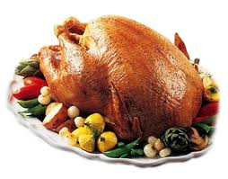
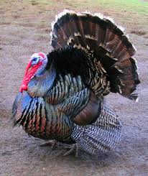
Selective breeding

Slide 10
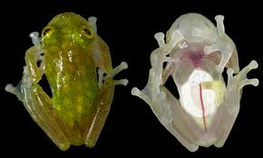
Selective Breeding

Slide 11
Inbreeding
Breeding individuals that are genetically similar
Ex: Plants and Animals: Protective Mechanisms

Slide 12
Hybridization
Crossing dissimilar individuals
Ex: Mule, Liger

Slide 13
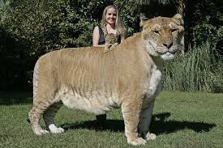
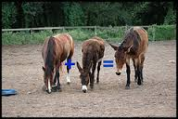
hybridization

Slide 14
Recombinant DNA
Joining together DNA from 2 or more sources, changing the genetic composition of living organisms
The DNA is created artificially
Ex: Diabetes (insulin and bacteria)

Slide 15
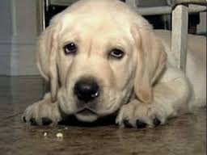
Cloning
Genetically identical organism produced from a single cell
Ex: dog

Slide 16
DNA Fingerprinting
Analyzing section of DNA that vary from individual to individual
These section may have little or no genetic value
Ex: Crime Fighting

Slide 17
Gene therapy
The process of changing a gene to treat a medical condition
Ex: Treating Cancer, Diabetes

Slide 18
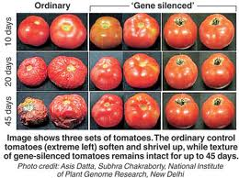
Transgenic
Organisms produced by the insertion of recombinant DNA into the genome of a host organism

