Slide 1
Warm Up 2/11-12
In pea plants, the allele for green seeds (G) is dominant to the allele for yellow seeds (g). Please do a heterozygous cross of 2 green seeded plants.
In snap dragons, red flowers (R) is incompletely dominant over blue flowers (B). Please do a heterozygous cross of 2 purple flowers.

Slide 2
Warm Up 2/13-14
Explain in your own words what a mutation is. Are mutations good or bad? Why?
Colorblindness is a sex-linked trait. Allie’s mother is a carrier for colorblindness and Allie’s father is colorblind. What are the odds that Allie will be colorblind. Show a Punnett square with genotype and phenotype.

Slide 3
Gene and Chromosome Mutations
Biology
Mr. Hedrick

Slide 4
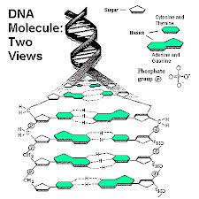
What is a Mutation?
Any change in the DNA sequence.
Is this a good or bad thing? Why?
Discuss with partner

Slide 5
Significance of mutations
Most are neutral, having little or no effect.
Mutations that dramatically change gene activity and protein structure (how?) may be harmful.
Mutations that enable an organism to better be equipped to live in an ecosystem are considered beneficial.

Slide 6
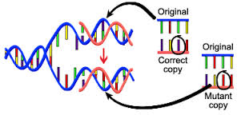
What causes mutations?
A failure of DNA to copy accurately
Mutagens: environmental causes of mutations
Name 3 possible mutagens

Slide 7
2 categories of mutations:
Gene mutations: makes changes to a single gene
Chromosomal mutations: makes changes in an entire chromosome

Slide 8
Examples of a change in a gene
Cystic Fibrosis
Sickle Cell Disease
Color Blindness
Please take notes on ONE of the following diseases.

Slide 9
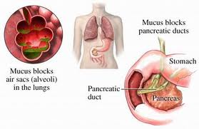
Cystic fibrosis
Recessive allele on chromosome 7
Are people with one dominant (normal) allele affected?
Most of the time it is a deletion of 3 bases (1 amino acid) in the middle of a protein sequence

Slide 10
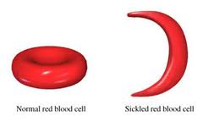
Sickle Cell Disease
One DNA base is changed which changes the amino acid
People with one normal allele are usually not affected
Alleles are considered to be codominant

Slide 11
Chromosomal Disorders
Defects in specific parts of the chromosomes (change in structure)
OR
An abnormal number of chromosomes
The change in number of chromosomes is nondisjunction

Slide 12
Chromosomal abnormalities
Autosomes
Down Syndrome: 3 copies of chromosome 21
Sex Chromosomes
Turner’s syndrome: female gets only 1 X
Klinefelters Syndrome: males get an extra X

Slide 13
Down Syndrome
3 copies of chromosome 21
1/800 babies
Unknown as to why the third chromosome causes a problem
Mild-moderate retardation
Susceptible to respiratory disease

Slide 14
Turner Syndrome
XO (allele) individuals are genetically female, however, they do not mature sexually during puberty and are sterile
Short stature and usually of normal intelligence (98% of fetuses die before birth)

Slide 15
Klinefelter’s Syndrome
XXY usually identifying as male
47 chromosomes
Underdeveloped sex organs
Usually very tall with androgynous features

