Slide 1
Warm Up 5/8-9
Which specific period would you like to live in? Why?
Why were dinosaurs so dominant during Mesozoic Era?

Slide 2
Warm Up 5/12-13
What are the 3 ways that scientists classify organisms?
What do cladograms show?

Slide 3
Evolutionary classification
Mrs. Heins and Mr. Hedrick
Biology 1

Slide 4
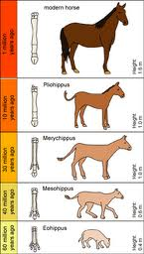
Evolutionary Classification
The strategy of classifying organisms together based on their evolutionary history
How may it be different from the 8 taxonomic levels of classification?

Slide 5
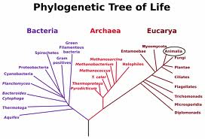
Phylogeny
Evolutionary development of organisms
It explores how living and extinct organisms are related to each other
It is often referred to as a phylogenic tree

Slide 6
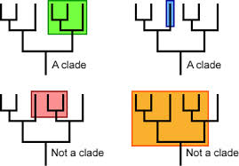
A Clade
A phylogenic tree is made up of clades.
A clade is a grouping that includes a common ancestor and all the descendants (living and extinct) of that ancestor

Slide 7
Clades Continued
Clades are nested within one another-they form a nested hierarchy. A clade may include many thousands of species or just a few.

Slide 8
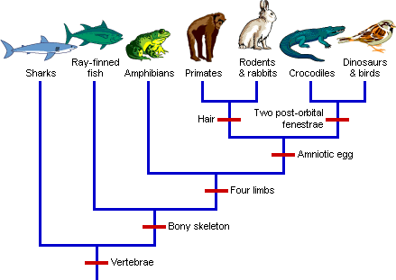
Derived Characteristics
Traits appear in recent parts of lineage, but not older parts of lineage
Derived character is one that evolved in the lineage leading up to a clade and that sets members apart from other individuals

Slide 9
Primitive Characteristics
Traits that organisms have in common
A structure NOT exclusively shared by all members of a specific group
Ex: Vertebrae are possessed by all birds but also by all other vertebrates. Possession of vertebrae cannot be used to distinguish the birds from other vertebrates since all vertebrates including birds share that trait.

Slide 10
Cladogram
A diagram that shows the evolutionary relationships among organisms
A type of evolutionary tree often constructed with a series of Ys or branches

Slide 11
