Slide 1
Warm up 2/24-25
What are biotic factors?
What are abiotic factors?
What do humans need from their environment in order to survive?

Slide 2
Warm Up 2/27-28
What is ecology?
What is the main purpose in studying ecology?

Slide 3
Warm Up 3/3-4
Draw one cycle of matter and explain what is going on.
Are nutrients created or destroyed? How do they move through ecosystems?

Slide 4
Video Questions
What do nutrients do in ecosystems?
What happens during the water cycle?
What happens during the carbon cycle?
What happens during the nitrogen cycle?
How are the redwoods made of salmon?

Slide 5
A few questions.
What do you know about Ecology?
What would you like to know?
What is an ecosystem?
What is the biosphere?

Slide 6
Ecology
Mr. Hedrick
Biology 1

Slide 7
Definition
The scientific study of organisms’ interactions with their environment.
This includes biotic and abiotic factors.

Slide 8
Key Terms
Biosphere:
The collection of all ecosystems on the planet or the zone that all life exists in
Biological Community
Groups of populations that interact with one another (predator/prey).
System (Ecosystem)
A set of interacting and interdependent parts forming a whole.
Biotic
Living factors
Abiotic
Nonliving factors

Slide 9
Interdependence
What does this trout depend on?
Discuss with Some one sitting next to you.
After you come up with a few things, discuss what those things depend on.

Slide 10
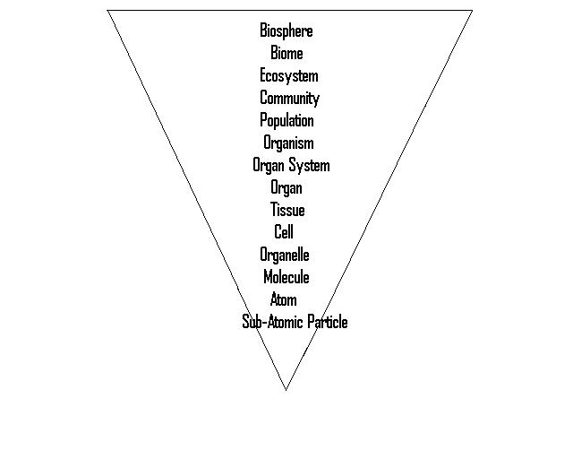
Where we are at now!

Slide 11
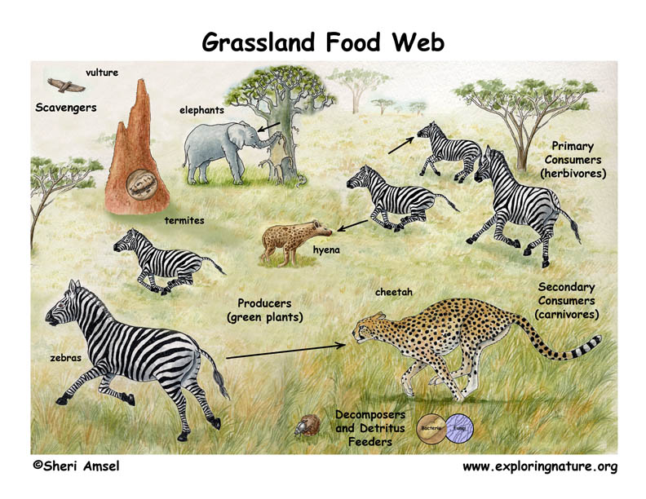
Energy
Measuring the flow of energy through an ecosystem is a primary purpose of ecology.
But also the cycle of matter.
Discuss what matter cycles might be.

Slide 12
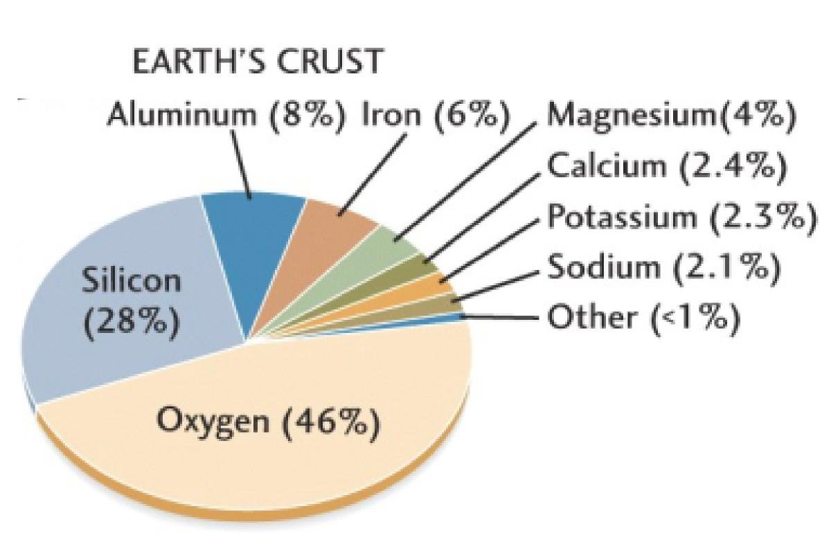
Review: Important Life Elements

Slide 13
What we need to know.
Water cycle
Nutrient Cycles
Carbon
Oxygen
Nitrogen
Phosphorous

Slide 14
Nutrient Cycle Readings
Each row will be given a nutrient cycle reading to do. The following needs to be accomplished for EACH reading:
What cycle are you talking about?
A brief drawing of the cycle.
How does this particular cycle work?
Two interesting facts about the cycle.

