Slide 1
Warm Up 3/12-13
What flows up the food chain, starting with the sun and ending with tertiary consumers?
Define in your own words:
Biomass
Trophic level
Entropy
What is the primary source of energy on the earth? What is another source of energy that life uses?

Slide 2
Energy Consumption Reading
Once this section has been reread, do the following things:
Write down 2 questions that you had about this section
Which things are consumed/produced during photosynthesis and cellular respiration? Are those things consumed/produced in equal amounts?

Slide 3
Ecological Pyramids
Mr. Hedrick

Slide 4
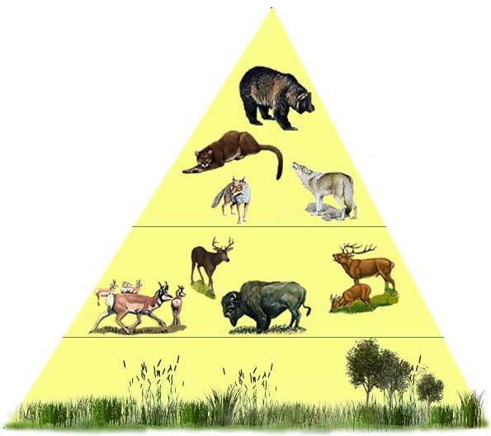
Ecological Pyramid
The pyramid shows the relationship between consumers and producers at different trophic levels in an ecosystem
It shows the relative amount of energy or matter contained with each trophic level in a given food chain

Slide 5
Three types of Pyramid
Pyramid of Energy
Pyramid of Biomass
Pyramid of Numbers

Slide 6
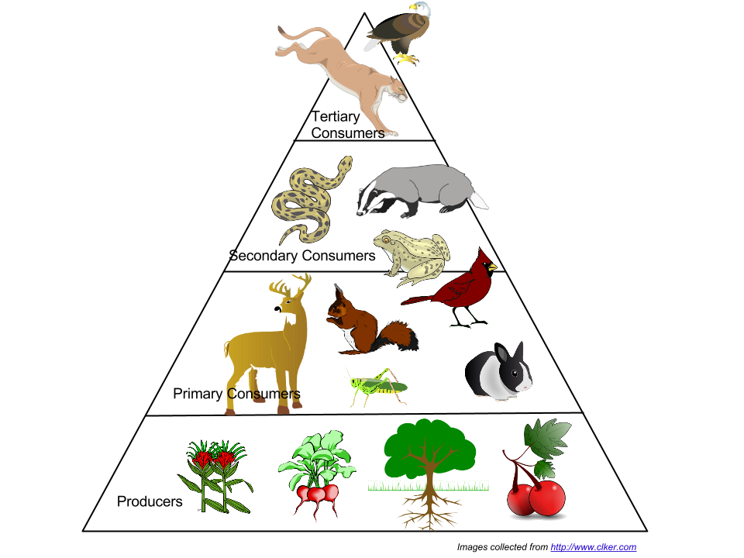
Take a look
Which level has the most energy?
Which level has the most organisms?
Which level has the least organisms?
Which level has the least energy?
Describe a few characteristics of each level.

Slide 7
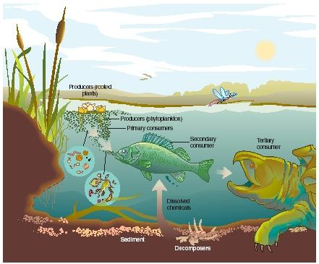
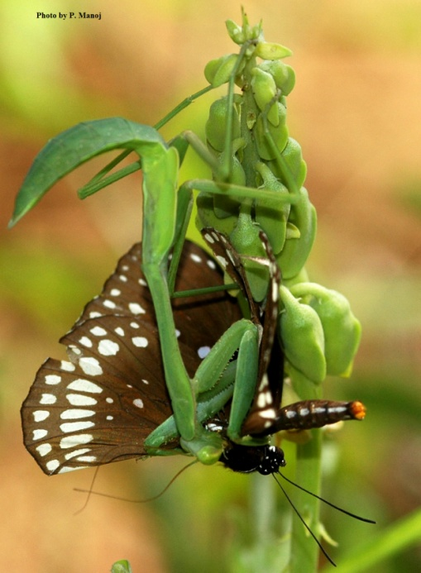
Trophic Levels
What does it mean to be a predator?
Energy moves from one organism to another when it is eaten
Each step in the transfer of energy is called a trophic level
Producers
Consumers
Decomposers

Slide 8
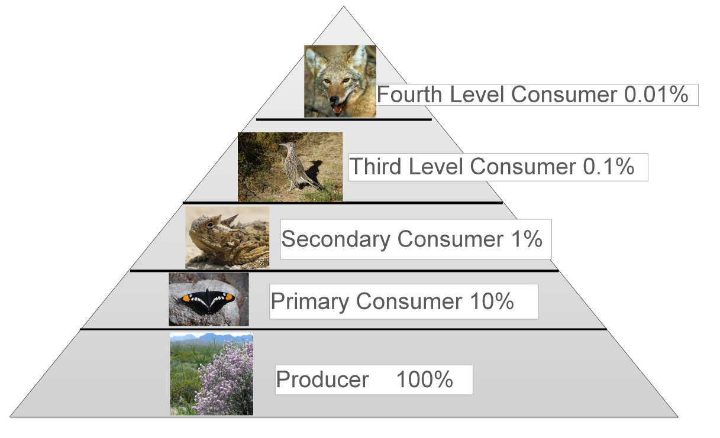
Energy Pyramid
Does all of the energy from the previous trophic level transfer why/why not?
Only 10% of the energy transfers to the next trophic level.
What does entropy have to do with this?
Producers/Autotrophes
Primary Consumers/Heterotrophes
Secondary Consumers/Heterotrophes
Tertiary Consumers/Heterotrophes
Decomposers/?

Slide 9
Warm Up
Compare the three ecological pyramids.
Describe the biotic community of the classroom?
What does biodiversity mean?
Why is biological diversity important and where do you think biological diversity is the greatest?

Slide 10
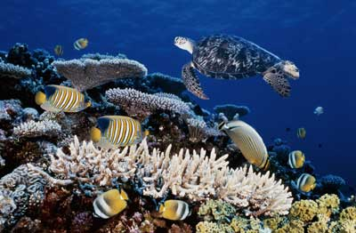
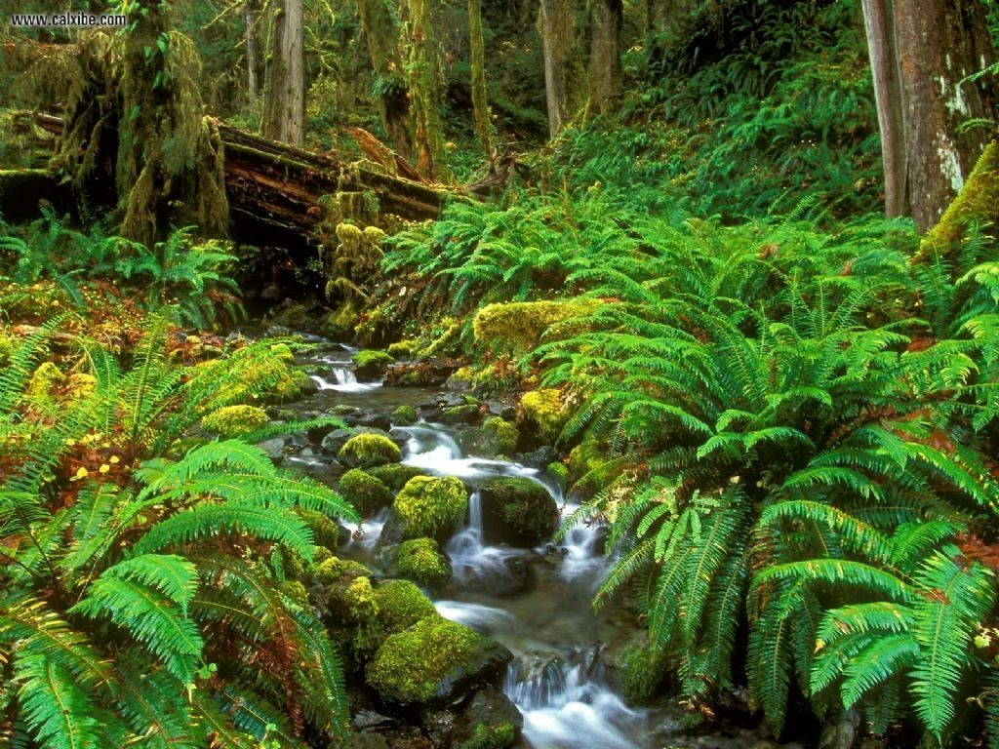
Biological Diversity
The degree of variation of life, including genetic information.

