Slide 1
Warm Up 12/10-11/14
Write down 1 thing that you know about DNA.
Compare/contrast photosynthesis and cellular respiration using a Double Bubble Map(3 in each column)

Slide 2
DNA Structure and Function
MRs. Heins, Mr. hedrick
Biology 1

Slide 3
Chromosome
Condensed chromatin
Sausage shape
Contains genetic information
Found in nucleus

Slide 4
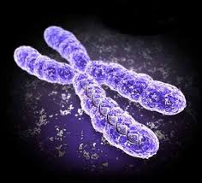
Chromosome

Slide 5
Genes
Chromosomes contain genes
A sequence of DNA that codes for a protein
Responsible for traits

Slide 6
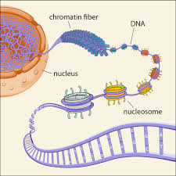
Chromatin
“Beads on a string”
DNA wrapped around a protein called a histone.

Slide 7
DNA (Deoxyribonucleic Acid)
Nucleic acid (macromolecule)
The molecule that makes up a chromosome
Double helix, 2 strands wound around each other

Slide 8
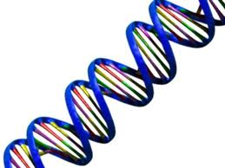
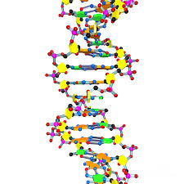
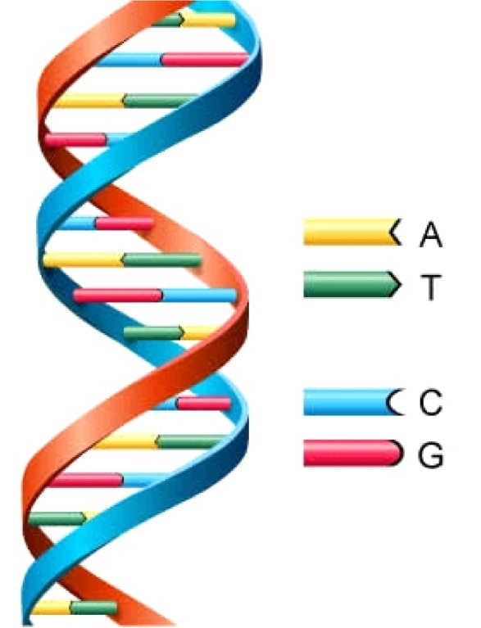

Slide 9
Nucleotide
Units within DNA molecule
Composed of:
5-Carbon sugar (deoxyribose)
A phosphate
A nitrogen containing base

Slide 10
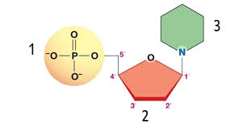
Nucleotide

Slide 11
Nitrogenous Bases
Purines
Pyrimidines
Adenine
Guanine
Two ring structure
Cytosine
Thymine
One ring structure

Slide 12
Base Pairing
Adenine ---- Thymine
Guanine ---- Cytosine
Thymine ---- Adenine
Cytosine ---- Guanine

Slide 13
Complete this DNA chain
Adenine ----
Guanine ----
Thymine ----
Guanine ----
Cytosine ----
Adenine ----
Thymine
Cytosine
Adenine
Cytosine
Guanine
Thymine

Slide 14
Warm Up 12/4-5
What are the 3 components of a nucleotide? Which component changes based on the nucleotide?
What is a chromosome? Where is it located? What is it constructed of?

