Slide 1
Warm Up 5/18
What is natural selection? Give an example that would happen in nature.
What is evolution? What 2 things cause it?

Slide 2
4/1-2/15
What was the first life like on Earth? Did it use oxygen? What challenges did it have to overcome?
How many years are there in an Eon?

Slide 3
Evolution and Darwin
Mr. Hedrick

Slide 4
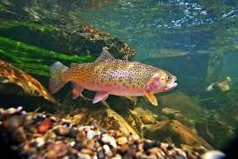
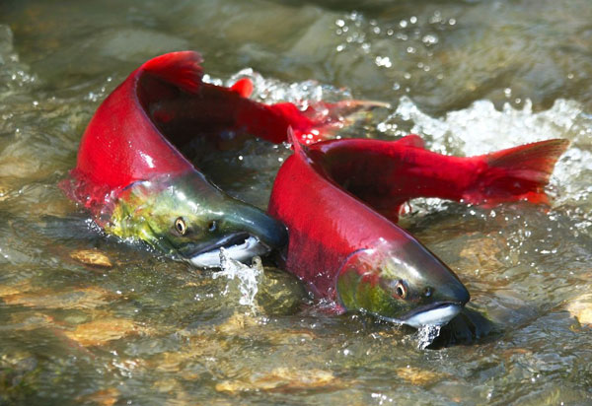
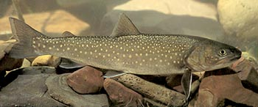
Which species is, evolutionarily, the closest? How do you know?
Animalia
Chordata
Actinopterygii
Salmoniformes
Salmonidae
Oncorhynchus
Clarki
Animalia
Chordata
Actinopterygii
Salmoniformes
Salmonidae
Salvelinus
Confluentus
Animalia
Chordata
Actinopterygii
Salmoniformes
Salmonidae
Oncorhynchus
Nerka

Slide 5
What really is evolution then?
The change in the genetic composition of a population over time

Slide 6
What Causes This?
Natural selection (survival of the fittest)
Artificial selection (genetic engineering)

Slide 7
Genetic Variation
How does genetic variation lead to natural selection?
Discuss with your partner

Slide 8
Evolution, two kinds
Microevolution
Macroevolution
Adaptations within a species.
Change of allele frequency within a population
Can lead to macroevolution
A change causing speciation
On the scale of different gene pools
Occurs at or above the level of species
What does it mean to occur at or above the level of species?

Slide 9
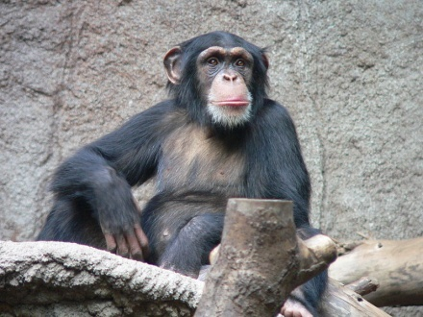
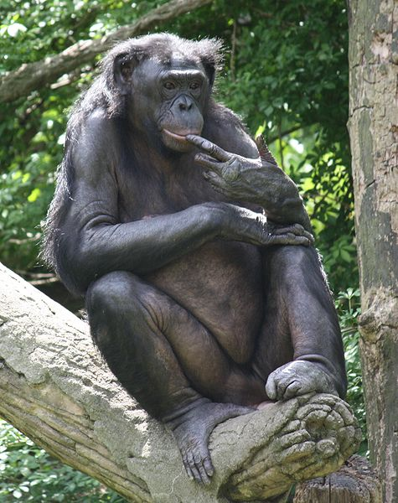
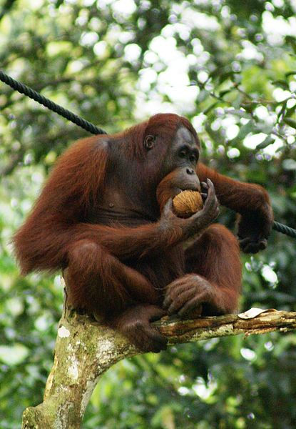
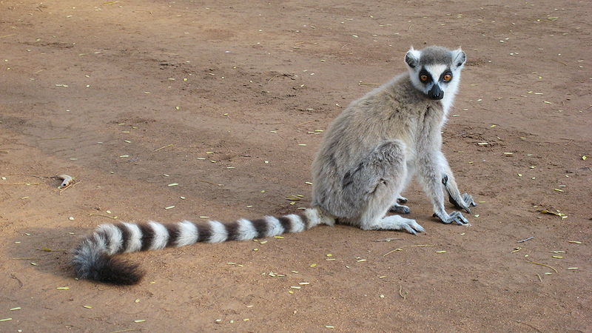
Another look!
Animalia
Chordata
Mammalia
Primates
Hominidae
Pan
Oken
Animalia
Chordata
Mammalia
Primates
Hominidae
Pan
Paniscus
Animalia
Chordata
Mammalia
Primates
Hominidae
Ponginae
Pongo
Animalia
Chordata
Mammalia
Primates
Lemuridae
Lemur
Catta

Slide 10
Who is this Darwin guy?
1809-1882
Naturalist and Geologist
Established common ancestry
His observations lead to the discovery of natural selection or the struggle to survive.

Slide 11
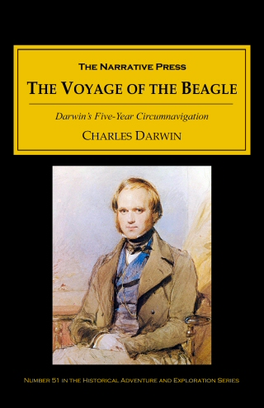
Voyage of the H.M.S. Beagle
A journey of discovery
Originally supposed to be three years, ended up being five
Through observation, data and specimen collection Darwin concluded that life changes over time.

Slide 12
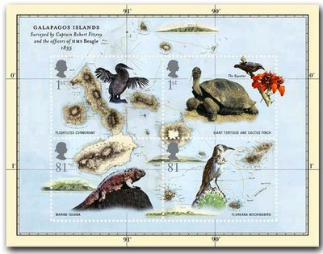
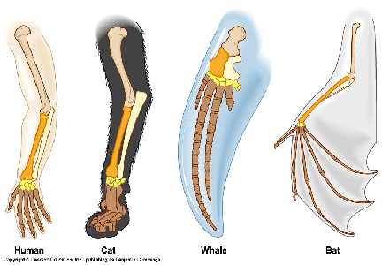
Observations
Looking at fossils and living organisms

Slide 13
Homologous Structures

Slide 14
Natural Selection
There was variation between organisms on different islands
Fitness
An organisms ability to survive.
Adaptation
An inherited characteristic that increases an organisms chances at survival
Put them together

Slide 15
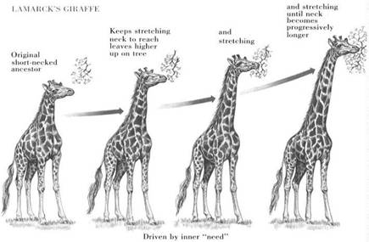
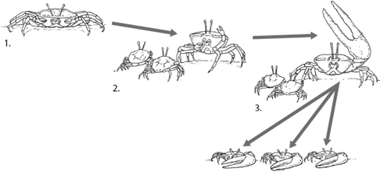
Timing is Everything
Darwin’s observations fueled by Lamarck’s theory of evolution.
Principles:
Tendency towards perfection
Use and Disuse
Inheritance of Acquired Traits
What are some problems?
Inheritance
Behavior

