Slide 1
Warm Up 3/13-16/15
Today we will be taking our end of quarter test. Please make sure that your binders are in order so they can be checked. This should include genetic inheritance notes, normal Punnett square problems (seed color etc.), incomplete dominance notes, alien family lab, blood type Punnett squares, human heredity notes, sex linked problems, Cracking the Code of Life Questions, Exploring Human traits lab (brown sheet), fruit fly lab, gene and chromosome mutation notes, and genetic engineering stay and stray

Slide 2
Classifying Organisms
Biology
Mrs. Heins, Mr. Hedrick

Slide 3
Why do humans classify things?

Slide 4
Number of Species Classified
Biologists have identified and named over 1.8 million species
It is estimated that anywhere from 2-100 million additional species have yet to be discovered.

Slide 5
Taxonomy
The study of the organization of living things into groups and assigning a name to the organism.
It allows scientists to study the diversity of life in a logical manner

Slide 6
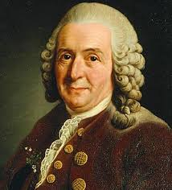
Carlous Linnaeus
Swedish Botanist
Lived in the 18th century
Developed a 2 word naming system called…

Slide 7
Binomial Nomenclature!
Bi=2, nomos=part or portion
Nom=name, cal=to call

Slide 8
Warm Up 3/17-18/15
How are living things classified?
How many living things do you think there are? Why?

Slide 9
Binomial Nomenclature
Each species is assigned a 2 part scientific name
The scientific name is always written in italics
The first word begins with a capital letter and the second word is in lower case
Why are they all in Latin? How is that less confusing?

Slide 10
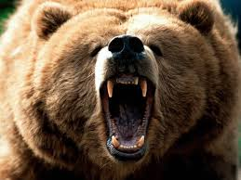
Binomial Nomenclature
Ursus arctos
Grizzly Bear

Slide 11
Warm Up 3/19-20/15
What is the scientific name for humans? What are the steps for writing it correctly?
Create a tree map describing the 3 domains of life.

Slide 12
Life
All living things are made of cells
All organisms are organized
All organisms obtain and use energy
All organisms try to maintain homeostasis
All organisms grow and develop
All living things reproduce

Slide 13
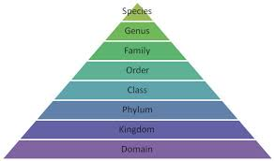

Slide 14
3 Domains and 6 Kingdoms
Eukarya
Archaea
Bacteria
Plantae (plants)
Animalia (animals)
Protista (microscopic living things)
Fungi
Archaebacteria
Eubacteria

Slide 15
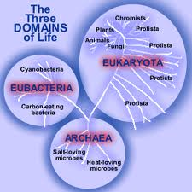

Slide 16
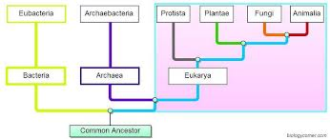

Slide 17
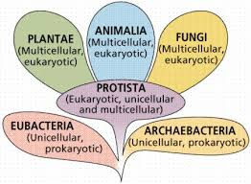
Which Domain is each of these kingdoms found in?

Slide 18
Levels of Classification
Domain
Kingdom
Phylum
Class
Order
Family
Genus
Species
Dumb
King
Phillip
Chases
Old
Fat
Girl
Scouts

Slide 19
Warm Up 4/30-5/1
Name the three domains. What are the main differences between them?
Create a 3 step dichotomous key to get to your shoes based on other shoes in the classroom (remember how we did this with backpacks last time).

Slide 20
The 7 Taxonomic categories
Kingdom-largest taxonomic group, consisting of closely related phyla. Ex: Animalia
Phylum-several different classes that share important characteristics. Ex:Chordata (subphylum vertebrata)
Class-composed of similar orders. Ex:Mammalia
Order-is a broad taxonomic category composed of similar families. Ex:Primate

Slide 21
The 7 Taxonomic Categories
Family-genera that share many characteristics. Ex:Hominidae
Genus-a group of closely related species. Ex: Homo
Species-a group of organisms that breed with one another and produce fertile offspring. Ex: sapien

Slide 22
Dichotomous Key
A tool that allows the user to determine the identity of living things in the natural world. Ex: trees, fish, flowers, reptiles
The key consists of a series of choices that lead the user to the correct name of the living thing.
“Dichotomous” means “divided into 2 parts”. Dichotomous keys always give 2 choices in each step.

Slide 23
Make your own dichotomous key
Create a dichotomous key that includes at least 3 steps to get to your shirt based on the shirts of others in the room.
Be sure that you choose factors that are easy to key out.

