Slide 1
Warm Up 9/30-10/1
Go to your notes and find the upside down triangle. On your upside down triangle:
Put a # near the level(s) that are at the chemical level
Put an * near the level that begins life
Put a + near the level that contains more than one organism
Put an @ at the first level that contains biotic and abiotic factors.
What is the most simple? What is the most complex?

Slide 2
Cell Structure and Function
Mrs. Heins, Mr. Cook, Mr. Hedrick
Biology 1

Slide 3
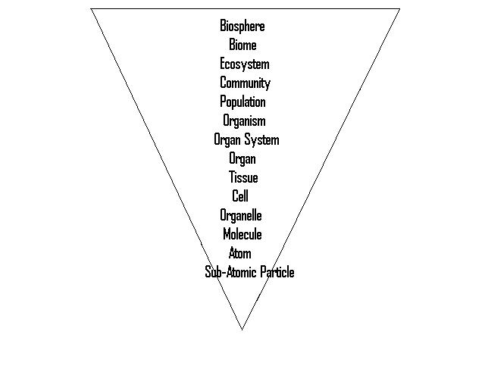
Organization Level
Living?

Slide 4
Cell Theory
All living things are made up of cells
Cells are the smallest working units of all living things
All cells come from pre-existing cells through cell division

Slide 5
Cell Theory
How would you set up an experiment to prove this concept wrong?
http://www.youtube.com/watch?v=4OpBylwH9DU

Slide 6
Definition of Cell
A cell is the smallest unit that is capable of performing life functions

Slide 7
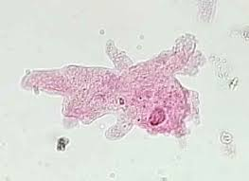
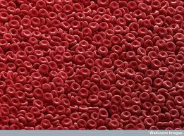
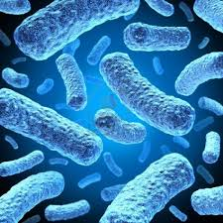
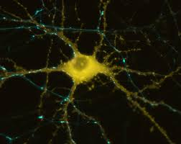
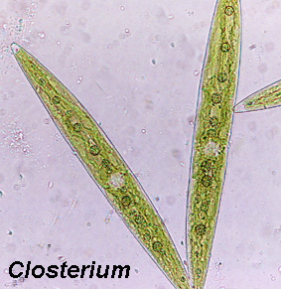
Examples of Cells
Amoeba
Red Blood Cell
Bacteria
Closterium
Nerve Cell

Slide 8
Two Types of Cells
Prokaryote
Eukaryote

Slide 9
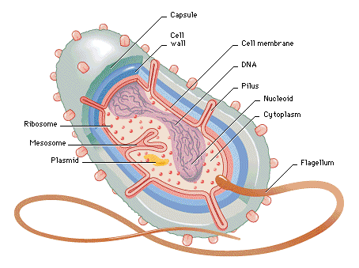
Prokaryotic
Do not have structures surrounded by membranes (no organelles)
Few internal structures
Unicellular
Bacteria or Archea

Slide 10
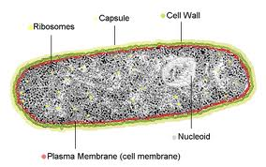
Prokaryote “Organelles”
Nucleoid- A region where the circular chromosome is located

Slide 11
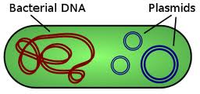
Prokaryotic “Organelles”
Plasmid-accessory (extra) rings of DNA

Slide 12
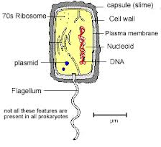
Prokaryotic “Organelles”
Capsule-An additional outer covering that protects the cell when eaten by other organisms, and helps the cell adhere to surfaces

Slide 13
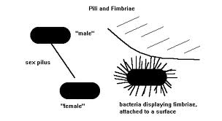
Prokaryote “Organelles”
Pilus-A hair-like appendage found on the surface of bacteria

Slide 14
Prokaryote
Grab a large piece of butcher paper and begin to draw a prokaryotic cell on HALF!!!!! of the paper.
The best ones will be used to decorate for future years so please be as artistic as possible
Please label all parts as well

Slide 16
Warm Up 10/2-3/14
Good morning! Today we will be taking a quiz, so please take the next 10 minutes to study and get your binder in order!
Daily Fixes, Physical/Chemical Properties notes and assignment, Entropy notes, Characteristics of life notes, Immortal Jelly Fish reading, Biological Organization jigsaw, Characteristics of life Lab, ALL warm-ups

Slide 17
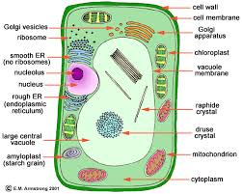
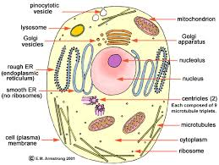
Eukaryotic Cell
Contain organelles surrounded by membranes
Includes most living organisms

Slide 18
Eukaryotic Cell
Please complete a eukaryotic cell on the other half of your butcher paper. You may use a plant OR animal cell.

