Slide 1
Cell Parts Organelles
Mr. Hedrick
Biology 1

Slide 2
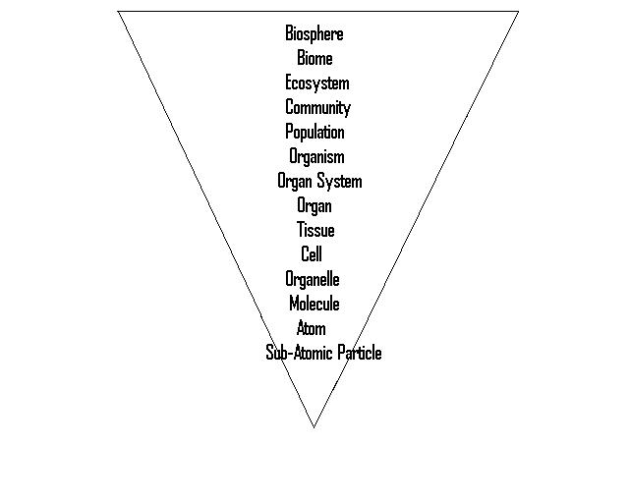
Living?

Slide 3
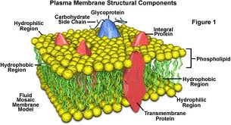
Surrounding the Cell
Plasma Membrane
Outer membrane of cell that controls movement in and out of the cell
Phospholipid Bilayer

Slide 4
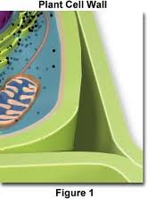
Surrounding the Cell
Cell Wall
Found mostly in plant and bacterial cells
Supports and protects cell
Plant cell wall is made of cellulose
Bacteria cell wall is made of peptidoglycan

Slide 5
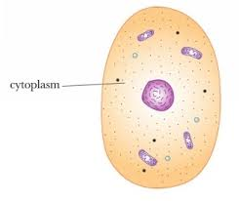
Inside the Cell
Cytoplasm
Gel-like mixture
Surrounded by cell membrane
Contains hereditary (genetic) material

Slide 6
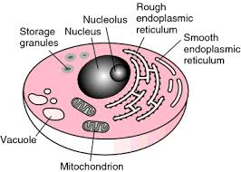
Inside the Cell
Nucleus
Directs all activities
Separated from cytoplasm by nuclear membrane
Contains genetic material-DNA

Slide 7
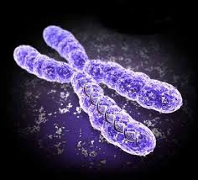
Inside the Cell
Chromosomes
Inside nucleus
Made of DNA
Contain instructions for traits and characteristics

Slide 8
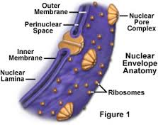
Inside Cell
Nuclear Membrane
Surrounds Nucleus
Made of 2 layers
Openings allow material to enter and leave nucleus

Slide 9
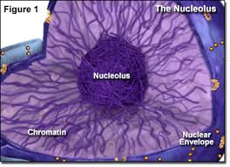
Inside Cell
Nucleolus
Inside nucleus
Contains RNA to build proteins

Slide 10
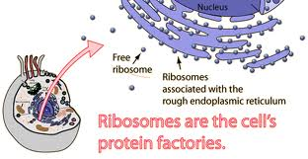
Inside Cell
Ribosomes
Each cell contains thousands
Make proteins
Found on endoplasmic reticulum and floating throughout cell

Slide 11
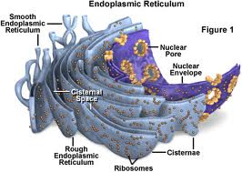
Inside Cell
Endoplasmic Reticulum
Moves materials around in cell
Smooth type: lacks ribosomes
Rough type: ribosomes embedded in surface

Slide 12
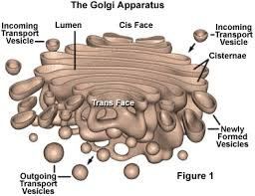
Inside Cell
Golgi Apparatus (body)
Protein ‘packaging plant’
Moves materials within cell
Moves materials outside cell

Slide 13
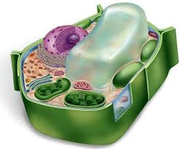
Inside the cell
Vacuoles
Membrane-bound sacs used for storage, digestion, and waste removal
Contains water solution
Helps plants maintain shape

Slide 14
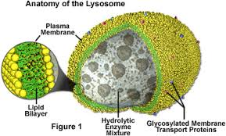
Inside the Cell
Lysosome
Digestive ‘plant’ for proteins , lipids, and carbohydrates
Transports undigested material to plasma membrane for removal
Cell breaks down if lysosome explodes

Slide 15
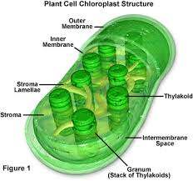
Inside the cell
Chloroplast
Usually found in plant cells
Contains green chlorophyll
Where photosynthesis takes place

Slide 16
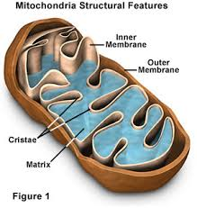
Inside the Cell
Mitochondria
Produces energy through chemical reactions-breaking down fats and carbohydrates
Controls level of water and other materials in cell
Recycles and decomposes proteins, fats, and carbohydrates

Slide 17
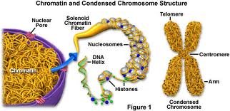
Inside the Cell
Chromatin
Made up of DNA and proteins (string of pearls)
It condenses to form chromosomes during cell division

Slide 18
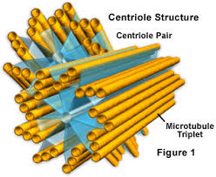
Inside the Cell
Centrioles
Cylindrical in shape
Composed of groups of microtubules by 9 by 3 arrangement
Needed for cell division

Slide 19
Warm Up 9/30-10/1
What level of biological organization is the smallest but still made of cells?
Which level of biological organization encompasses all life?
Which prokaryote “organelle” contains most of the cell’s genetic material?

Slide 20
Nucleus Questions
What is the nucleus compared to?
What types of things are in the nucleus?
How are the things inside the nucleus protected?
Why is the genetic material like an architect’s blueprint?

Slide 21
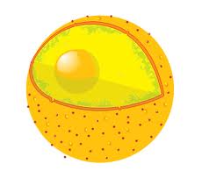
Warm Up 10/2-3
Which organelle is this?
What is its function?
Complete a Venn diagram on a prokaryotic and eukaryotic cell

Slide 22
Ribosome Questions
Where do the instructions to make proteins come from?
How do the instructions for making a protein make it out of the nucleus?
Where are the proteins made?
What are the ingredients for proteins?

