Slide 1
Warm Up 12/16
Draw a DNA nucleotide and label its parts.
What is mitosis?

Slide 2
Warm Up 1/7-8
What was the most exciting or fun thing you did over winter break?
What was the most interesting part of this class in the first semester?

Slide 3
Warm Up 1/16-20/15
Draw the process of translation. Label tRNA, mRNA, ribosome, amino acid, codon, and anti-codon.
What are the 3 types of RNA. What do each do?

Slide 4
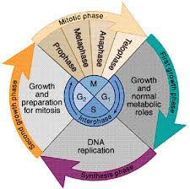
Cell Cycle and Cell Reproduction
Mr. Hedrick and Mrs. Heins
Biology 1

Slide 5
Need For Reproduction
Reproduction-living things producing other living things
Not necessary for one organism
Is necessary for the survival of a particular group of organisms

Slide 6
Circle Map
Create a circle map with your partner using any words you know that describe cell division.

Slide 7
Cell Division
All cells come from other cells through cell division
Cells either divide or die at a certain size
If a cell becomes too large, its surface area to volume ratio becomes too large for easy molecule exchange
Talk to your partner about what surface area to volume ratio is.

Slide 8
Cell Division
Cell Division- a complex series of changes in the nucleus that leads to the making of 2 new cells
2 new cells are called daughter cells
Daughter cells usually have identical nuclei as the parent cell
Daughter cells can then grow and divide, repeating the process

Slide 9
Mitosis
All cells in the body (besides sex cells) are reproduced through mitosis
Mitosis- a series of changes in the nuclei of body cells that produce identical daughter cells

Slide 10
Stages of Mitosis
Mitosis is an ongoing process but can be described in these stages
Prophase
Metaphase
Anaphase
Telophase

Slide 11
Warm Up 1/21-22/15
Good morning! Today we will be taking a quiz and doing a binder check. Your binder needs to include: DNA structure and function notes, origami DNA, RNA notes, Strawberry DNA extraction lab, DNA review worksheet, transcription notes, translation notes, and translation activity.
We will also be taking a quick formative assessment before the quiz.

Slide 12
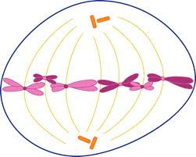
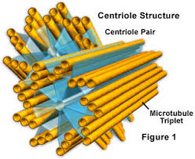
Organelles Needed In Cell Division
1. Centrioles: these separate and take positions on opposite sides of nucleus

Slide 13
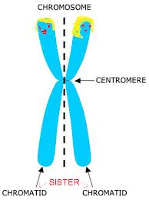
Organelles Needed
2. Chromatid: one of two identical copies of DNA making up a replicated chromosome

Slide 14
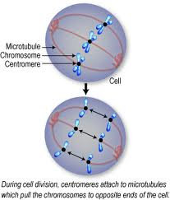
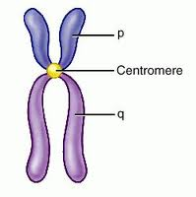
Organelles Needed
3. Centromere- a region of DNA found near the middle of the chromosome, where sister chromatids are attached

Slide 15
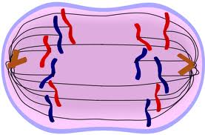
Organelles Needed
4. Spindle fibers: microtubules that move chromosomes during cell division

Slide 16
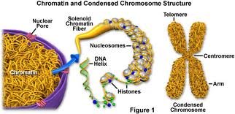
Organelles Needed
5. Chromatin: granular material found in the nucleus. It consists of DNA and proteins. Condenses to form chromosomes.

Slide 17
Time to jigsaw!
Today we will be doing jigsaw with the focus on the stages of mitosis. You will need to have the following information in your “expert groups”
1. What is happening in your stage of mitosis
2. A drawing of the stage of mitosis
3. Is the nucleus present? Are there chromosomes present? What organelles are involved?
4. A prepared animation or video of the stage.
5. One interesting fact

Slide 18
Group Responsibilities
Pink-Interphase
Green-Prophase
Yellow-Metaphase
Purple-Anaphase
Blue-Telophase and Cytokinesis

Slide 19
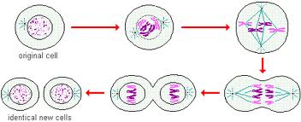
Mitosis

Slide 20
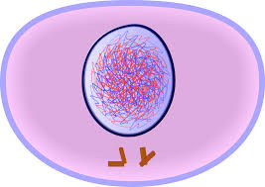
Interphase
The period between cell divisions
Single stranded chromatin replicates (make an extra copy)
Chromosomes cannot be seen
3 phases: G1, S, and G2

Slide 21
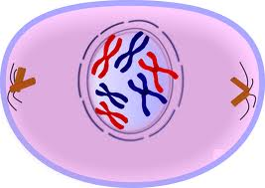
Prophase
Double stranded chromosomes become visible and nuclear membrane disappears
A spindle apparatus, consisting of fibers, forms on opposite poles of cell

Slide 22
Metaphase
Chromosomes move to the middle of the cell and line up at the cell equator (midline)

Slide 23
Anaphase
Double-stranded chromosomes separate and move to opposite poles of the cell
There is a complete set of chromosomes at each pole of the cell

Slide 24
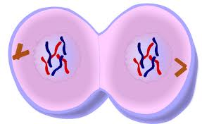
Telophase and Cytokinesis
Nuclear membrane forms around each set of chromosomes, making 2 identical nuclei
Cytokinesis- cytoplasm divides, forming 2 new identical daughter cells

Slide 25
Warm Ups 1/9-10
What is happening during the anaphase of mitosis?
What happens if a cell gets too big? Why?

Slide 26
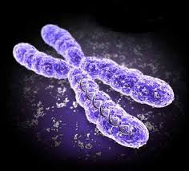
Warm Up 1/13-14
Which stage of mitosis is pictured?
Name this DNA structure and label the parts.

Slide 27
Cell Division Video Questions
1. What are the 3 parts of interphase called?
2. What is the goal of mitosis?
3. Name 2 things that are happening in prophase.
4. Name 1 thing that is happening during metaphase.
5. Name 1 thing that is happening during anaphase.
6. Name 1 thing that is happening during telophase.
7. Name 1 thing that is happening during cytokinesis.

