Slide 1
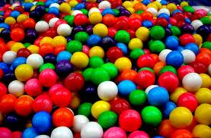
Bubble Gum Lab

Slide 2
Qualitative vs. Quantitative
What is the difference?
Quantitative
Observations that can be measured concretely and mathematically.
Generally these observations are more objective.

Slide 3
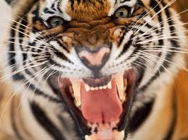
Qualitative vs. Quantitative
Qualitative
Describes the properties or characteristics of what is being observed.
Generally the more subjective of observations.

Slide 4
Qualitative vs. Quantitative
Describe the tiger in a qualitative fashion.
Describe the tiger in a quantitative fashion.

Slide 5
Bubble Gum Lab
Please separate into groups of 5 or 6. If this is done quickly and efficiently, free partnering will become the norm.
Once a group has been formed, migrate to one of the 6 tables or lab stations. 1 member of the group will grab the gum, 1 will grab the meter stick, one will grab the string, and one will grab the wax paper, while another will begin setting up the paper for the experiment.

Slide 6
Bubble Gum Lab
Each person will need a finished lab in their binders. Photocopies or hand copies will be permitted.
Please DO NOT write on the hard copies of the lab.
Carefully read all instructions before beginning the lab.

