Slide 1
Warm Up 5/13-14/15
What Biome does Idaho fit into?
Make a double bubble map to compare and contrast ecosystem with biotic community.
What is the difference between a coniferous tree and a deciduous tree?

Slide 2
Terrestrial Biomes
Mrs. Heins and Mr. Hedrick

Slide 3
Biome
An environment with the following similar characteristics:
Climate
Soil conditions
Animals
Plant life
What is biotic and what is not?

Slide 4
World terrestrial biomes!

Slide 5
Rainfall

Slide 6
Tundra
Northernmost biome
Characterized by permafrost.
What do you suppose permafrost is?
What would this limit?
Discuss with your neighbor.

Slide 7
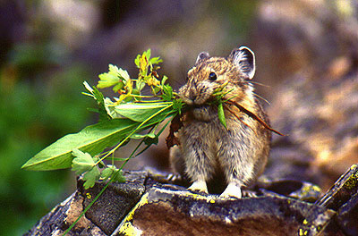
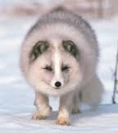
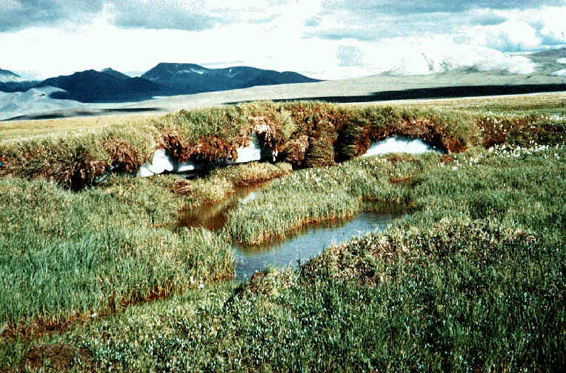
Tundra
Mostly treeless
Covered by low growing moss and grass
Few animals migrate to tundra during summer months

Slide 8
Boreal Forest/Taiga
Located South of the Tundra
Winters are extremely cold and summers are mild
Dominated by great coniferous forests of fir, spruce and pine

Slide 9
Warm Up 5/15-18/15
What is a terrestrial biome?
Describe the main factors of 1 terrestrial biome and explain why specific biotic factors are there (eg. Why there are a specific types of trees in a specific biome).

Slide 10
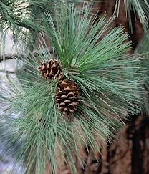
Boreal Forest/Taiga
Needle like leaves and cones well suited for the environment

Slide 11
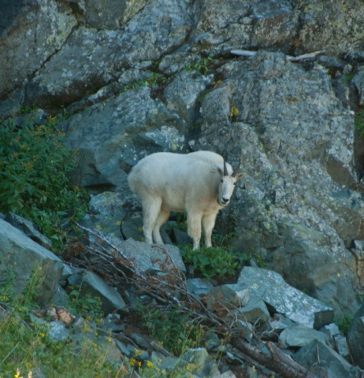
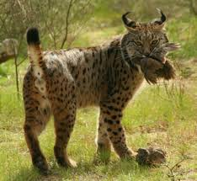
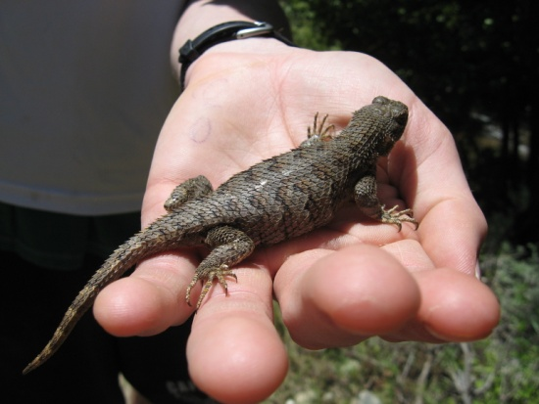
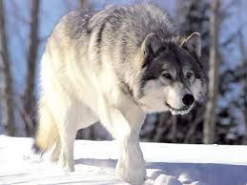
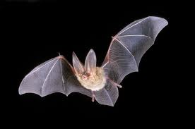
Boreal Forest/Taiga
Animals aplenty

Slide 12
Temperate Deciduous Forests
South of the taiga
Characterized by changing seasons and falling leaves
Oak, maple and beech
Sufficient rain fall
Humus on forest floor
More or less animals?

Slide 13
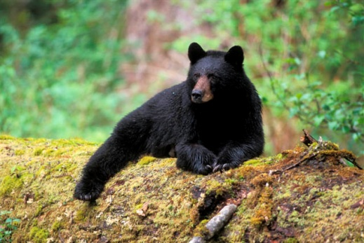
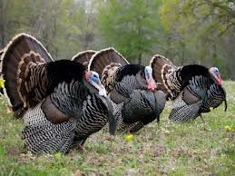
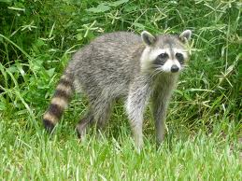
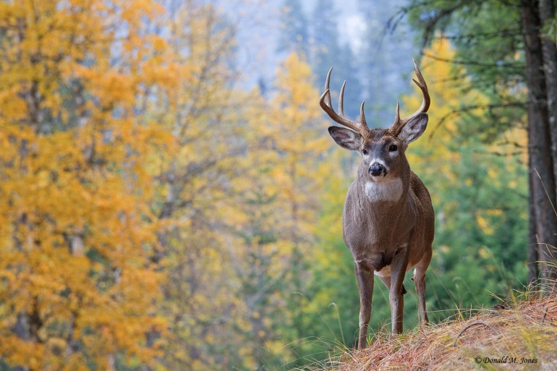
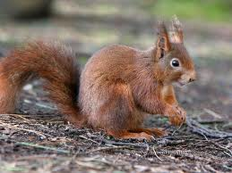
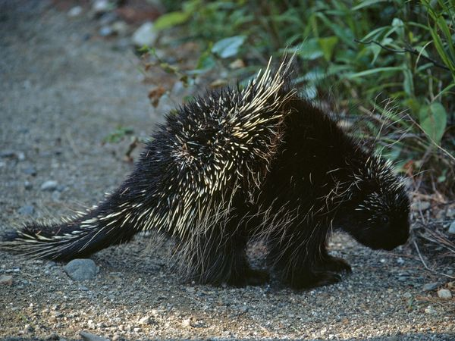
Temperate Deciduous Forests
A little more
Many animals live in both

Slide 14
Grassland
Discuss with a neighbor and come up with three characteristics of a grassland.
Vast areas covered with grass and small leafy plants
Usually found in the interior of continents
Does north America have a large grassland?

Slide 15
Grassland
Yes, The Great Plains!
Most precipitation occurs in one season
Hot summers, cold and windy winters.
Tell me about the animals!
Why is fire important to these biomes?

Slide 16
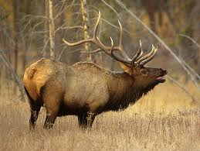
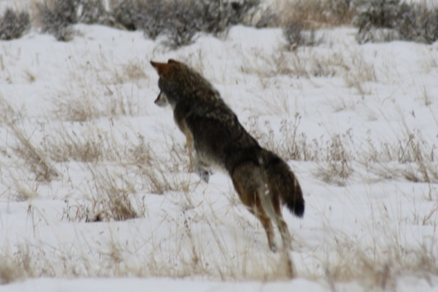
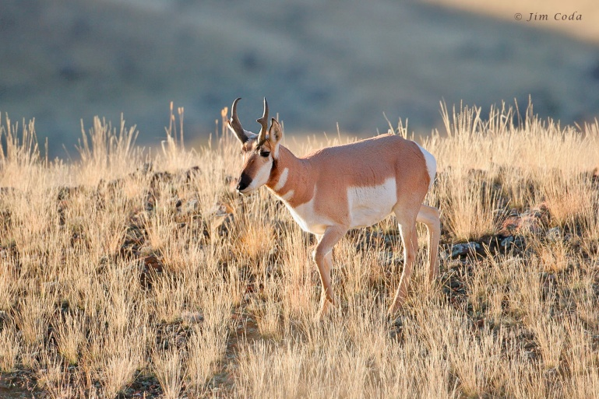
Grassland
Lots of herbivores
Lots of carnivores
What is the difference between grassland and savannah?

Slide 17
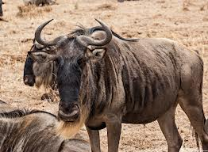
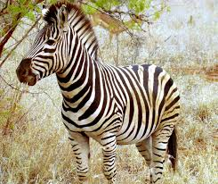
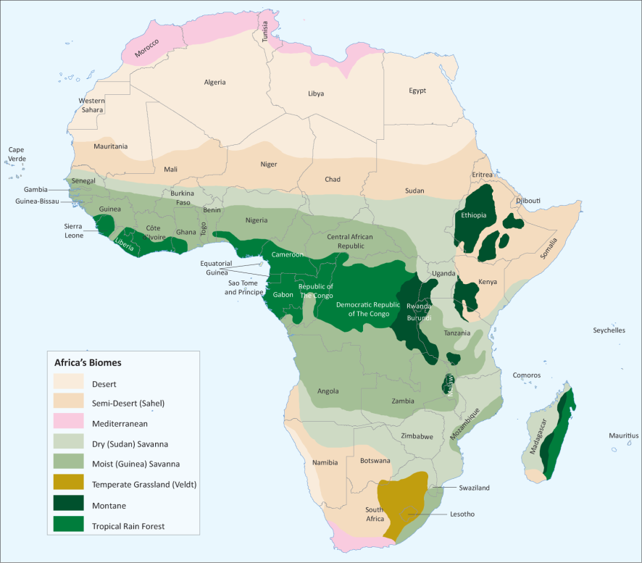
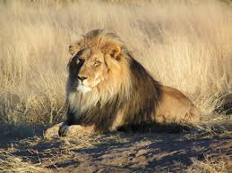
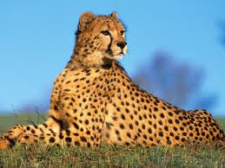
Savannah
Tropical grassland
Where is the equator?
Why are there more large predators in the savannah than the great plains?

Slide 18
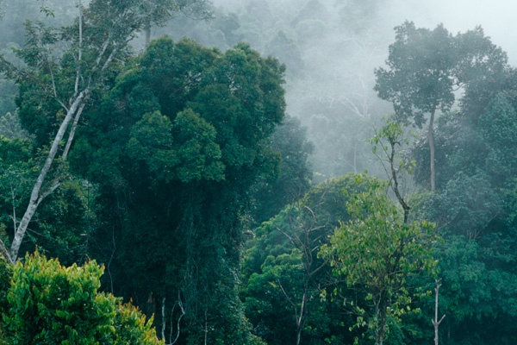
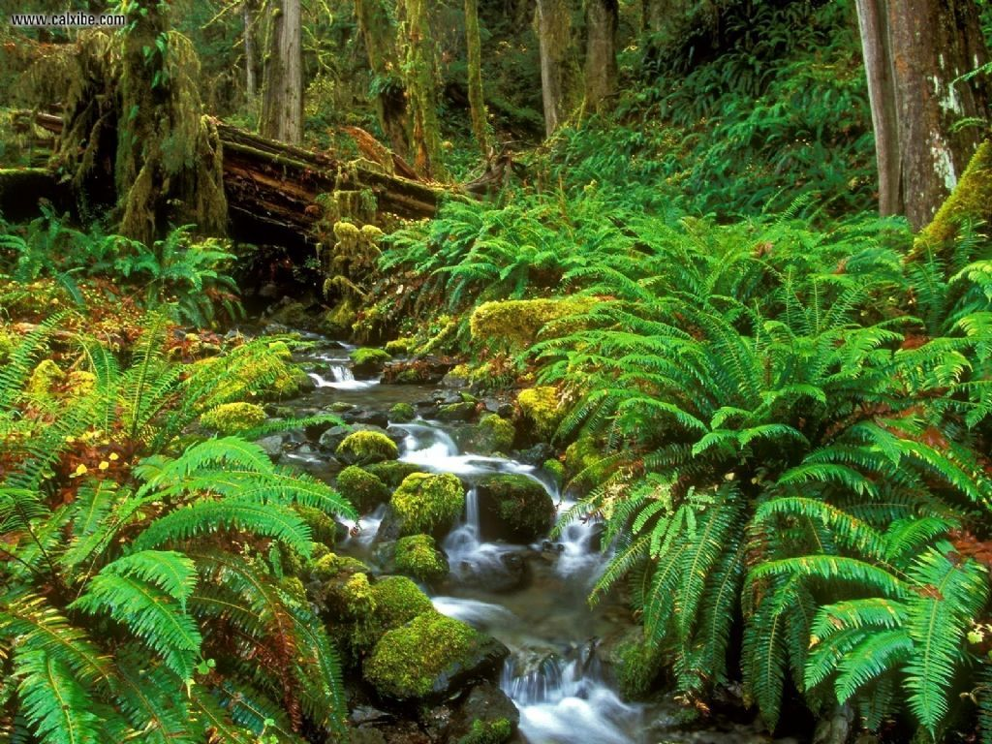
Tropical Rain Forest
Biodiversity
Warm and rainy year round
Near the equator
Layers of a rainforest

Slide 19
Biodiversity
How would these layers support biodiversity?
Rainforests support more biodiversity than any of the other biomes combined

Slide 20
Niche
the position or function of an organism in a community of plants and animals
Where would a mammal’s niche be in the tropical rainforest?
What kind of things would occupy the forest floor niche?

Slide 21
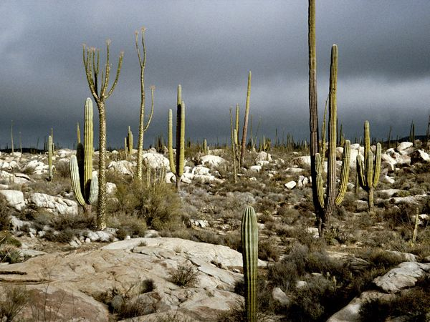
Desert
Are all deserts hot?
Rainshadow
Less than 25 cm of rainfall a year
Sahara – worlds hottest desert
How do plants and animals adapt to this kind of climate?

Slide 22
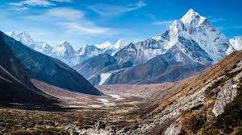
What did we miss?
Northwestern coniferous forests
Tropical dry forest
Temperate wood and shrub land
Many more
Those that aren’t easy to classify
Mountain ranges
Caves

