Slide 1
Warm Up 5/5-6/15
What are the basic steps of the phosphorous cycle?
What is interdependence? How are ecosystems interdependent?

Slide 2
Warm Ups 3/14-17
Is the area around our campus very diverse? Why or why not?
Does calculating a diversity index tell you the true diversity of an area? Why or why not?

Slide 3
Ecology Reading
Once you have completed your summary, read the selection again.
Write down at least 2 things you found interesting and 2 questions that you had about the article.

Slide 4
Biodiversity
Mr. Hedrick
Biology 1

Slide 5
What is biodiversity?
The total number of organisms in the biosphere OR the total number of organisms in a specified area.

Slide 6
Why is biodiversity important?
Discuss with a partner why you think biodiversity is important.
Each partner should have 2 reasons written down for notes.

Slide 7
How do we calculate diversity?
1. Count how many total species are in a particular area (4 different species).
2. Count how many (or estimate % coverage) of each species is in a particular area(20 of species A).
3. Count total number of all living things found.
4. Divide # of species by total living things.

Slide 8
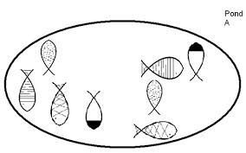
Example
As a class we will calculate the diversity index.

Slide 9
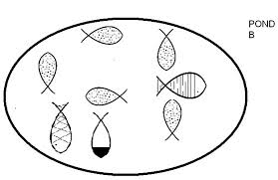
Example
With your shoulder partner, calculate the diversity index:

Slide 10
Example
Which pond was more biodiverse? Why?

Slide 11
Let’s Do a Real World Survey!
I will place you in groups of 3 and we will do a vegetation (plant) survey.
Each person will need their own survey sheet.
Each group will need 1 hula hoop.

Slide 12
Let’s Do a Real World Survey!
In order for the sample to accurately represent the area, you will GENTLY TOSS one hula hoop in a random direction
Use your vegetation surveys to find # of species and total plants counted.
We will repeat this process at 4 different locations.

Slide 13
Concluding Questions
Calculate the total diversity index around our school (use notes if you don’t remember).
Is the area around our school very diverse? Why or why not?
Where is an area near to us (~50 miles) that would be the most diverse? The least diverse? Why?
Why is biodiversity important (think about our discussion on interdependence)?
Are human processes increasing or decreasing biodiversity? What can we do to change that trend?

Slide 14
Ecosystem Reading
What was the most interesting part of the entire article to you?
What would you like to learn more about after reading this article?
Did your summaries include some of the same things that the author had in his summary? What did he have that you left out?

