Slide 1
Warm Up
Describe the process of natural selection in your own words.
What natural occurrence could split a species in two?
Figure 15-15 on page 384 is an example of what?

Slide 2
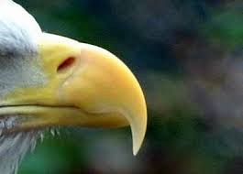
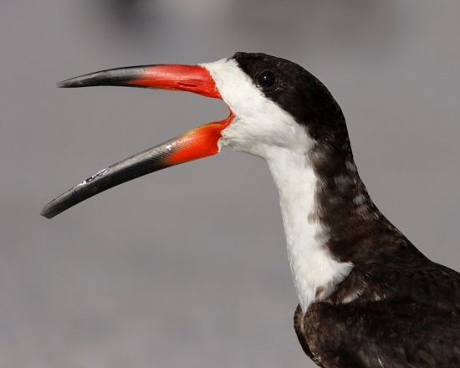
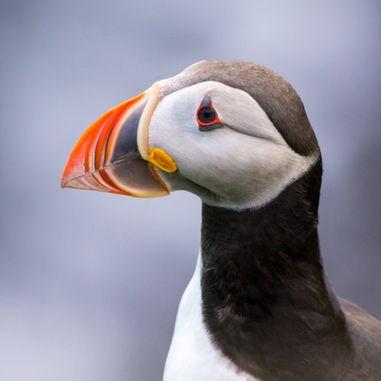
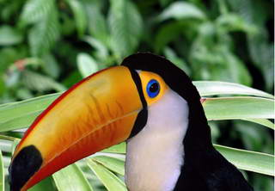
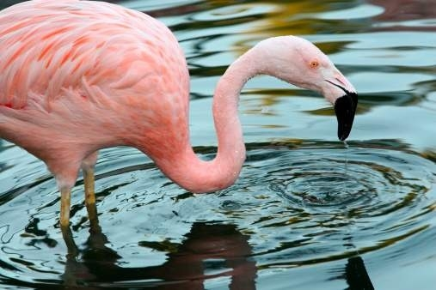
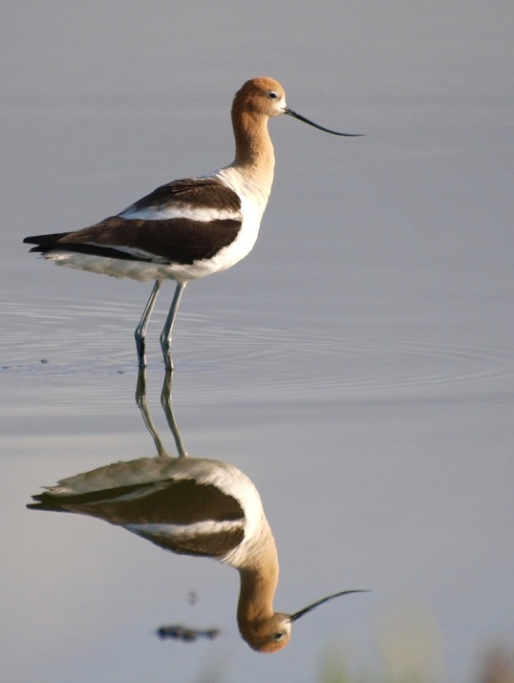
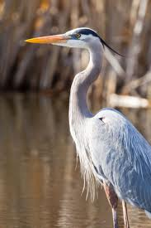
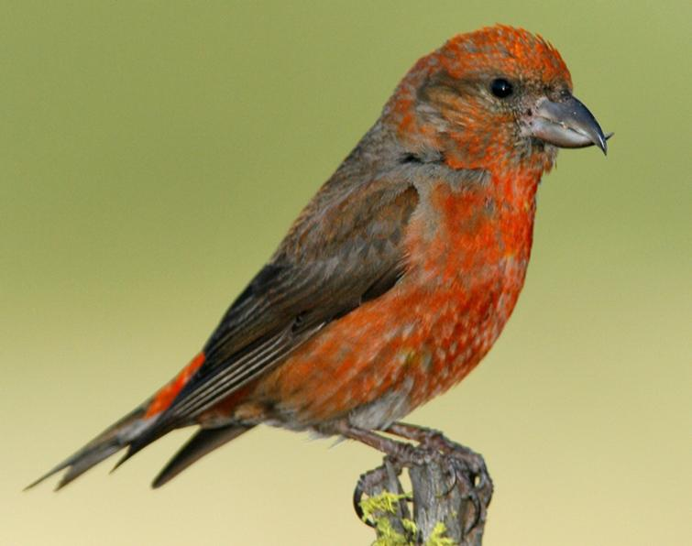
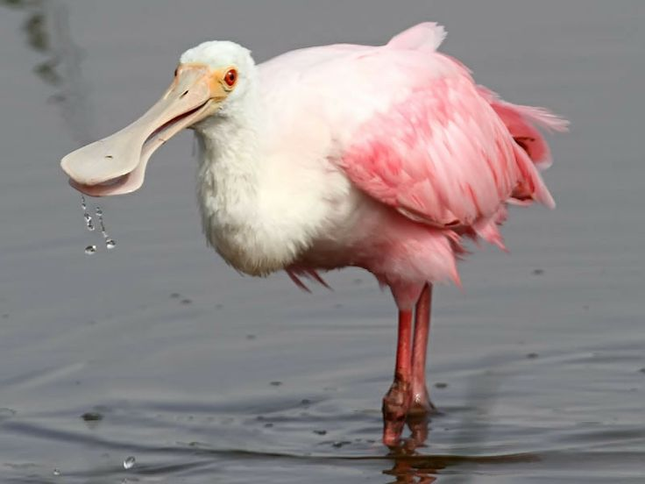
The Better Beak
Mr. Hedrick
Mrs. Heins

Slide 3
Procedures
Count out 50 of each:
Beans
Peas
Corn
Beak and stomach, one hand each
First trial, 1 minute, grab as many as possible.
Bird that ate the least goes extinct
Bird that ate the most reproduces (add one more of that bird.)
Food that was most consumed goes extinct
Food that was least consumed reproduces (add thirty of that food.)
Second trial, 1 minute, grab as many as possible.
Draw conclusion
Finish filling out answers and return to seat.

Slide 4
Post Lab
Answer on your own.
Answer in complete sentences.
Is this an accurate example of natural selection? Why/why not?
What may happen if the environmental conditions changed? (Picking up food from grass.)
Why might different beaks work better in other groups?
If you were to carry out the experiment three more times what do you predict the outcome would be, why?
Come up with a situation that the spoon might work the best.

