Slide 1
Warm Up 5/19-20/15
Describe/Draw a rain shadow. Which type of biome does this cause?
Create a double bubble map describing any 2 biomes.

Slide 2
Aquatic Biomes
Mr. Hedrick

Slide 3
Two Major Types
What are they?
Marine
Freshwater

Slide 4
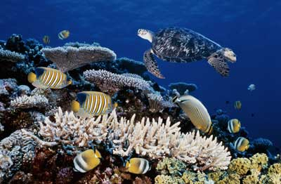
Marine Ecosystems
Also split into two main groups. Discuss with a partner what these might be.
Photic Zone
Aphotic Zone
What does photic mean?

Slide 5
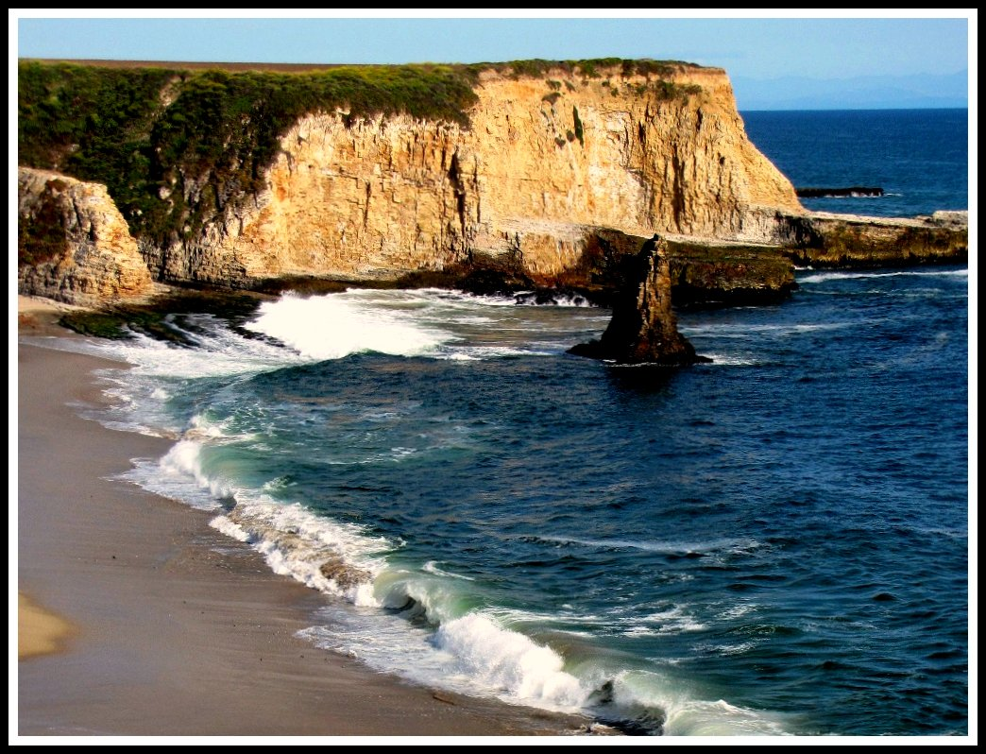
Subdivided further
Intertidal
Coastal (Neritic)
Open Ocean
Benthic

Slide 6
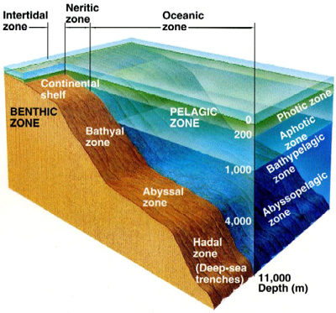
Zones

Slide 7
Intertidal Zone (Shoreline)
Tell me a little about the intertidal zone.
Organisms are not always submerged.
Adaptations?

Slide 8
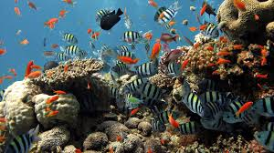
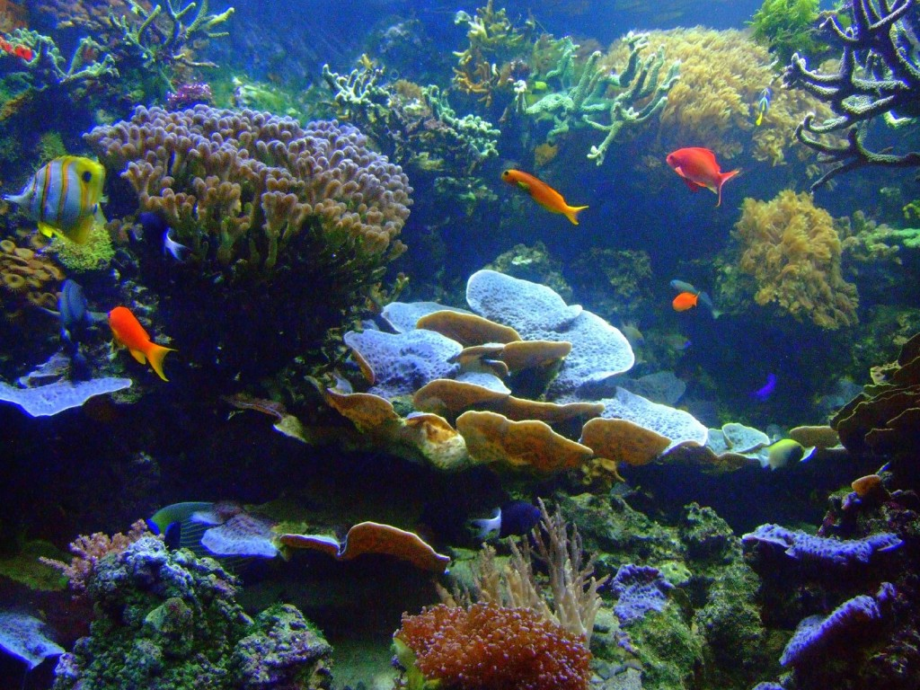
Coastal (Neritic Zone)
Extends from low tide mark to the outer edge of the continental shelf.
Photosynthesis usually occurs in this region so it is also a…
Photic Zone
Kelp Forests and Coral Reefs
Tell me about the animals.

Slide 9
Nutrients and Coral Reefs
What seems to be the current issue with the relationship between coral and nutrient levels?
What are the benefits to having coral reefs present in costal biomes?
What question would you ask Dr. Wiedenmann about his article if you had the opportunity?

Slide 10
Open Ocean (Oceanic)
Begins at the end of the continental shelf and extends outward
Largest zone
Typically has low level of nutrients mostly consumed by phytoplankton.
Why do you think it has lower nutrient levels?

Slide 11
Warm Up 4/4-7
Describe, in detail, 1 marine biome.
What adaptations have intertidal organisms made over time in order to be successful?

Slide 12
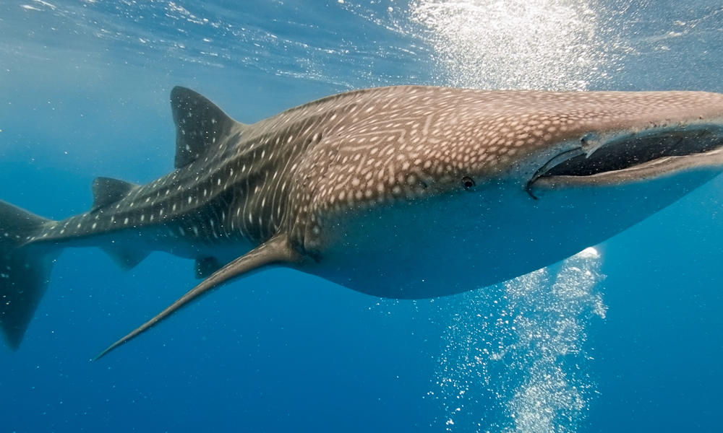
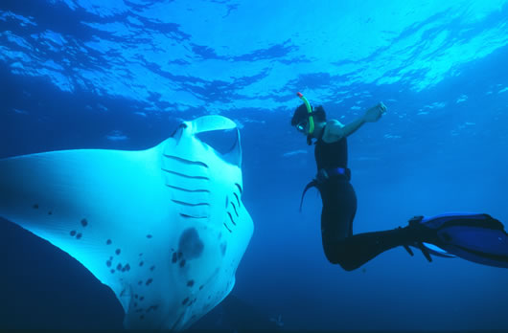
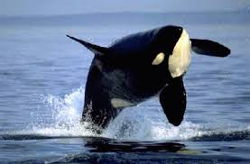
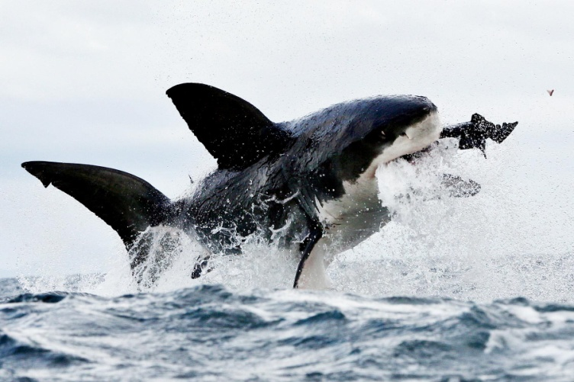
Open Ocean
Animals
What adaptations might they have?
The two largest animals alive today live in this zone. What do they have in common?

Slide 13
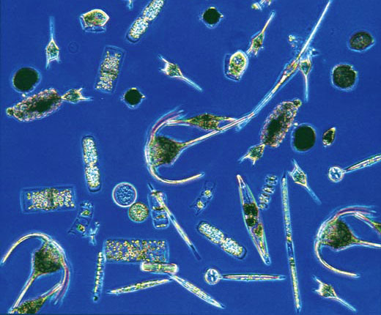
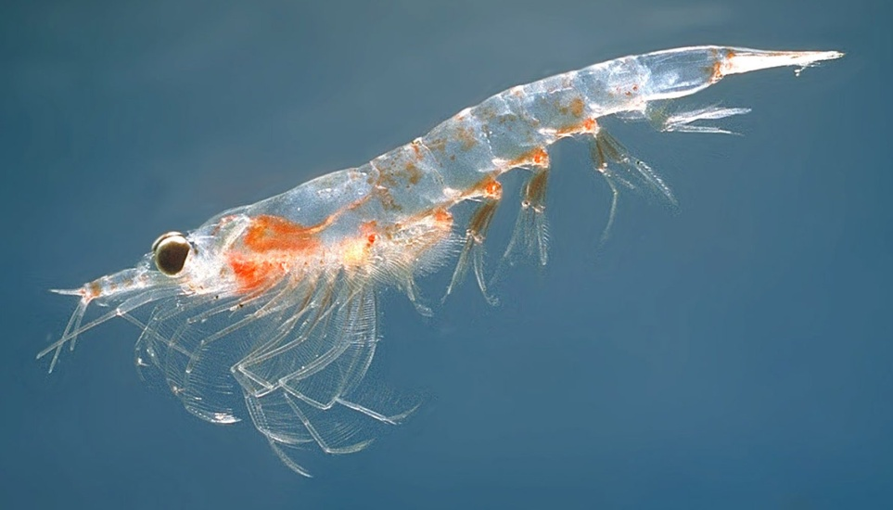
What is plankton?
Singular, plankter
A general term for free floating organisms found in fresh and salt water
Phytoplankton
Responsible for half the worlds oxygen
Autotrophic
Many can’t be seen with the naked eye
Basis of aquatic animal food
Zooplankton
Feed on phytoplankton
Many are too small to be seen by the naked eye
Includes krill

Slide 14
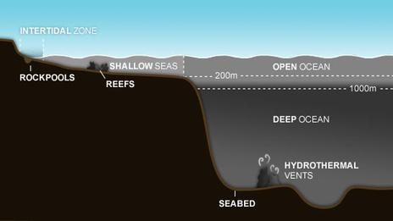
Benthic Zone
What makes this different?
Adaptations to live here?
Ocean Floor
Area of high pressure, cold temperatures and total darkness
How do the animals get energy?
Some producers are chemosynthetic
Aphotic

Slide 15
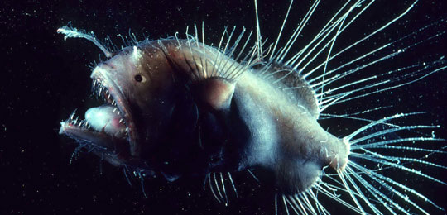
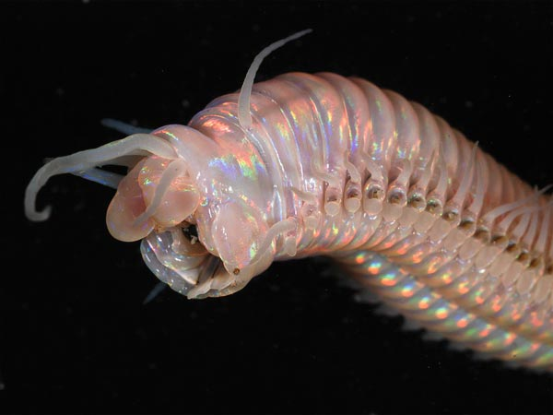
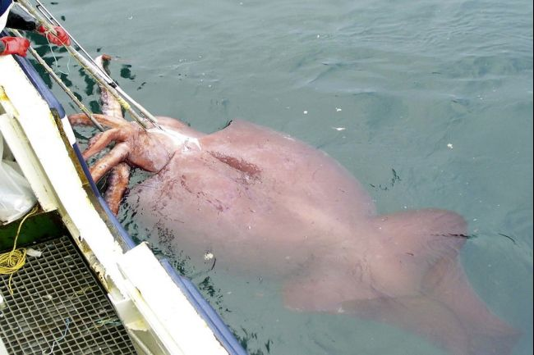
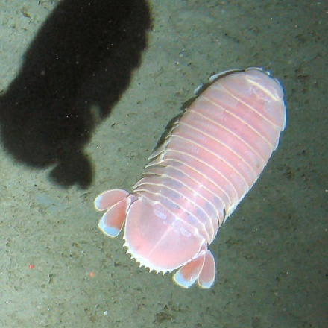
Animals of the Deep

