Slide 1
Warm Up
Describe a wetland. What are some characteristics?
How did the Grand Canyon form?
How do you suppose the plankton in the ocean is different from that of freshwater systems.
Why is the Great Salt Lake so salty?

Slide 2
Warm Up 4/14-15
Describe a wetland. What are some characteristics?
How did the Grand Canyon form?

Slide 3
Aquatic Biomes
Mr. Hedrick

Slide 4
Warm Up 4/8-9
Complete a Venn diagram comparing/contrasting 2 marine biomes.
What adaptations have benthic animals made in order to live in their environment?

Slide 5
Warm Up 4/10-11
Which terrestrial and marine biomes have the most biodiversity? Why?
Name 2 biomes where large animals live. Why do they live there?

Slide 6
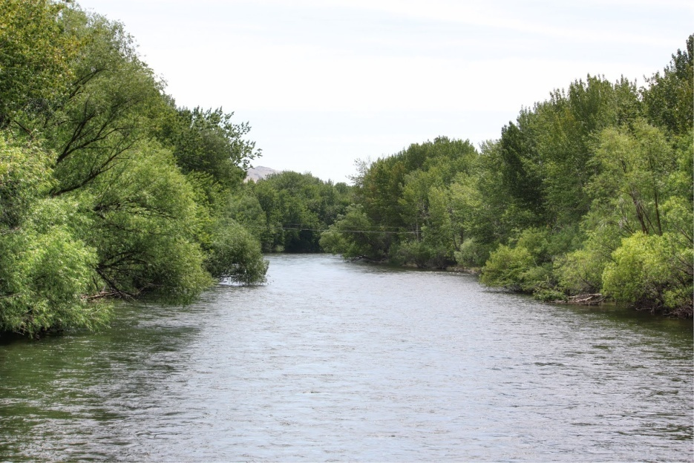
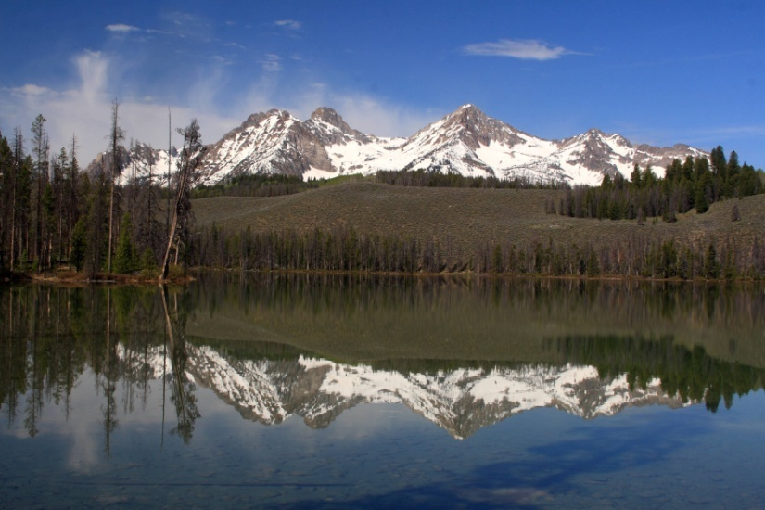
Freshwater
Flowing
Standing
Rivers
Streams
Creeks
Lakes
Ponds
Reservoirs
What am I missing?

Slide 7
Take a look, its in the book
Take a few notes from your books about freshwater biomes. Make sure you pay close attention to what makes them different.

Slide 8
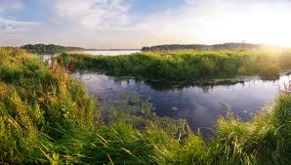
Wetlands
Why are wetlands important?
Water covers the surface or is near the surface for part of the year
Water may be flowing or standing
Fresh, salty or brackish

Slide 9
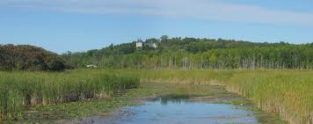
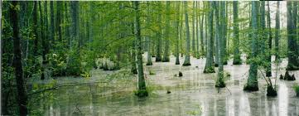
Freshwater Wetlands
Bog: Dominated by moss formed in depressions where water collects
Marsh: Shallow, along river, contain cattails
Swamp: trees and shrubs, looks like a flooded forest
How do you suppose they are different?

Slide 10
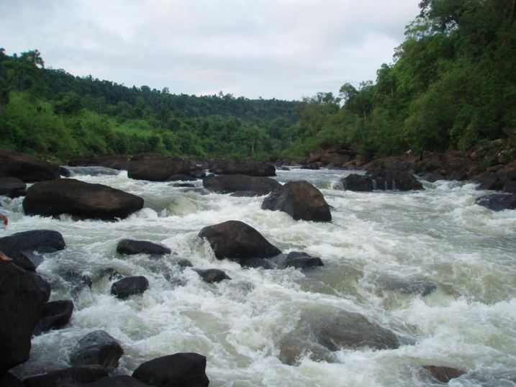
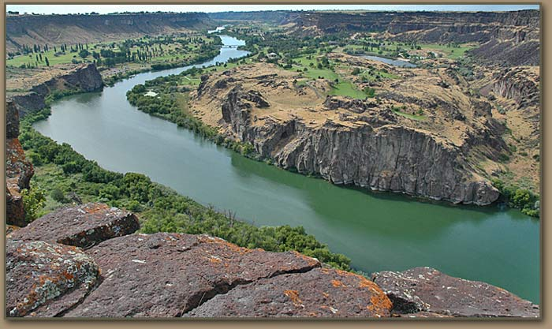
Flowing Water
Creeks vs. streams vs. rivers
Flow rate
Age
What, do you suppose, is an indicator of a rivers age?

Slide 11
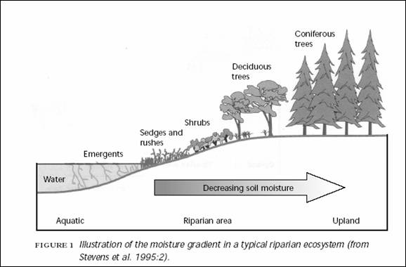
Riparian Zone
Water to land interface
Why would this be important?
What is a water table?
The wolf and the watershed.

Slide 12
River Order
Discuss with your neighbor what some differences between a 1st and 4th order channel might be.

Slide 13
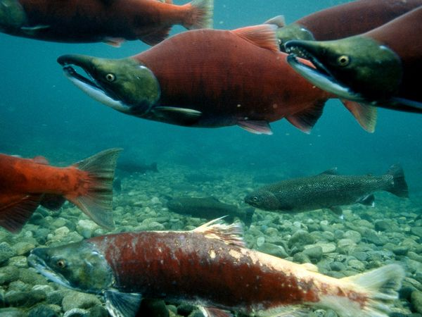
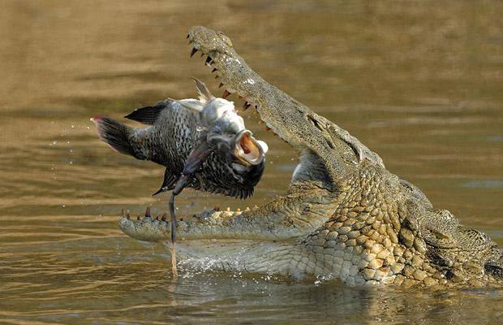
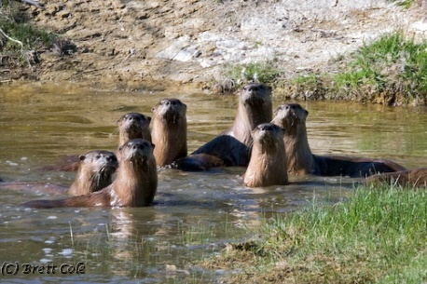
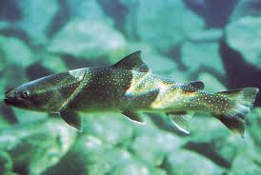
Rivers, arteries of the planet

Slide 14
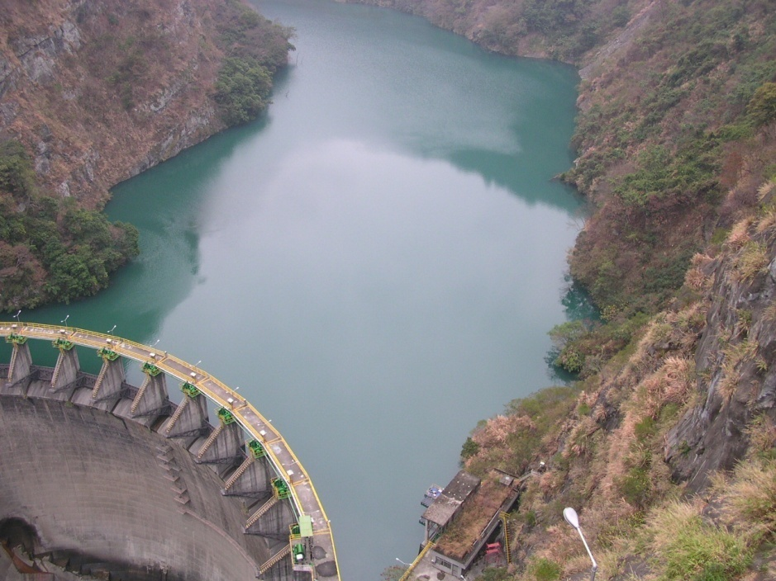
Standing Water
Lakes
Ponds
Reservoir
What is the difference?
Eventually what will happen to all lakes and ponds?

Slide 15
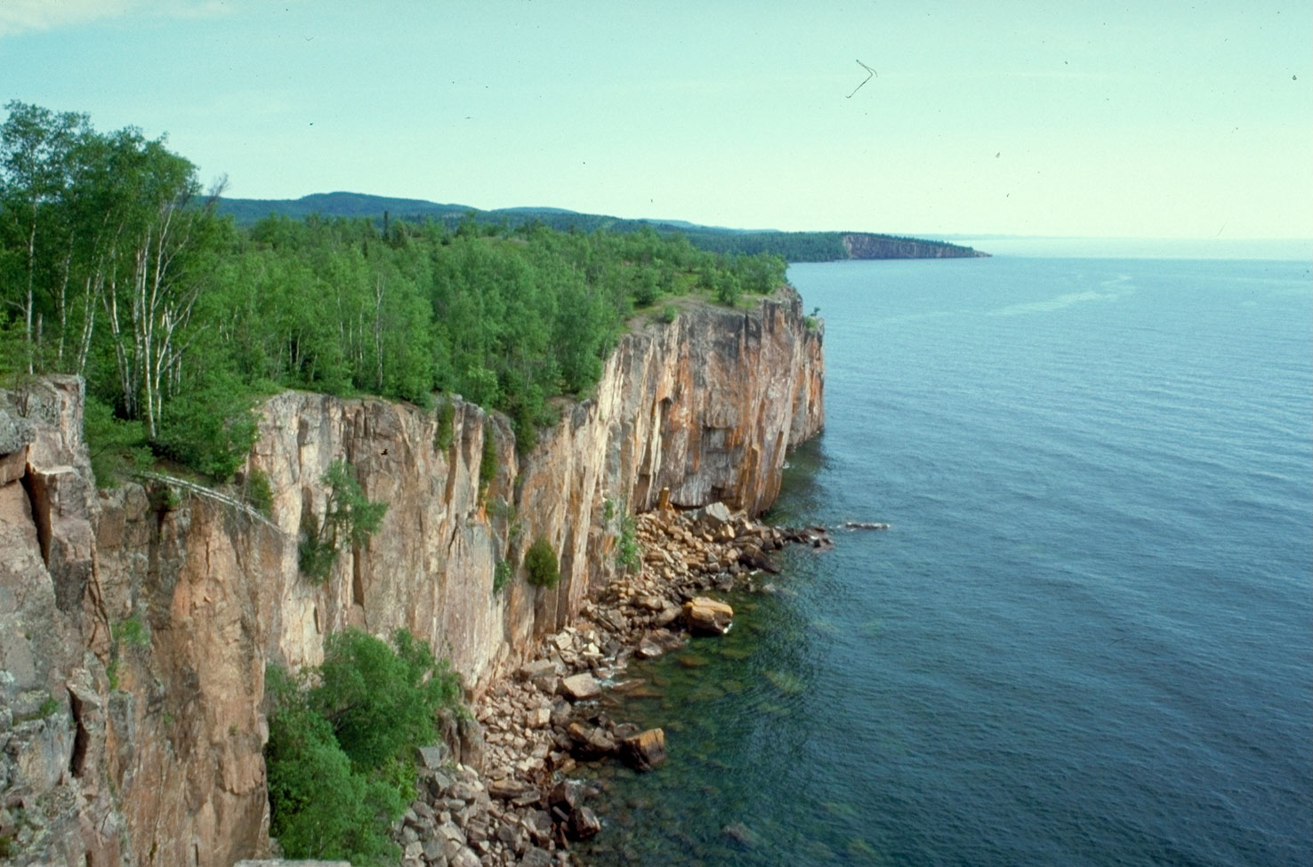
How do lakes form?
Tectonic/rift lakes
Glacial lakes
Saline lakes
Volcanic/caldera lakes
Oxbow lake
Reservoirs

Slide 16
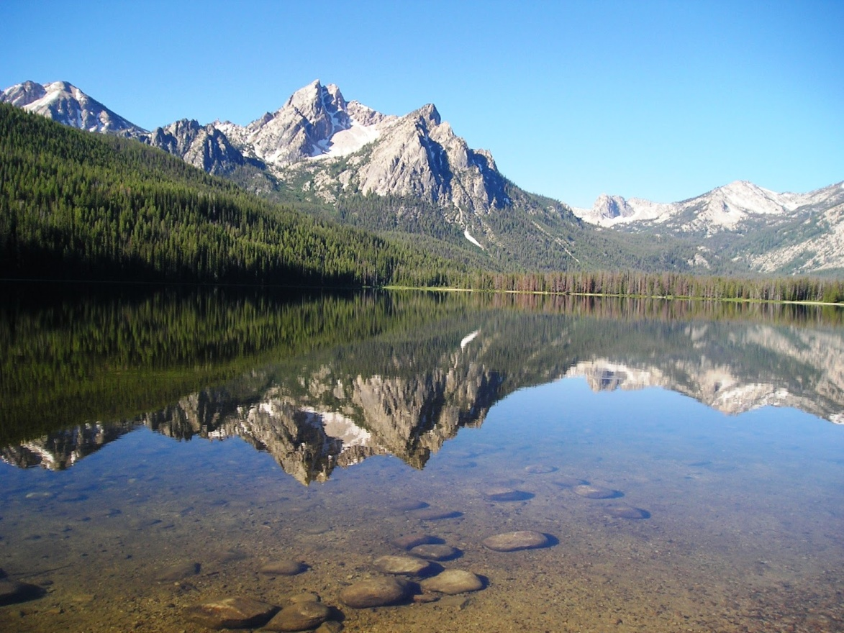
Double Bubble Map
Rivers
Lakes

Slide 17
Symbiosis
A close and long lasting interaction between two different organisms. Can benefit one or both and can harm one as well.
Each person will be getting an organism. It is your job to go around the room and find your symbiotic partner. There is an even number of cards so all organisms will have a partner.

Slide 18
Symbiosis
Once you are in your partner groups, please determine if your relationship helps both (+/+), helps one (+/0), or helps one and harms one (+/-).
Our special names for each- mutualism (+/+), commensalism (+/0), and parasitism (+/-)
Partnerships that show mutualism will go to the corner of the room with binders, partnerships that show commensalism will go to the snake cage, and partnerships that show parasitism will go to the front.
Read the paper at each location to check your answers.

